Slide 1
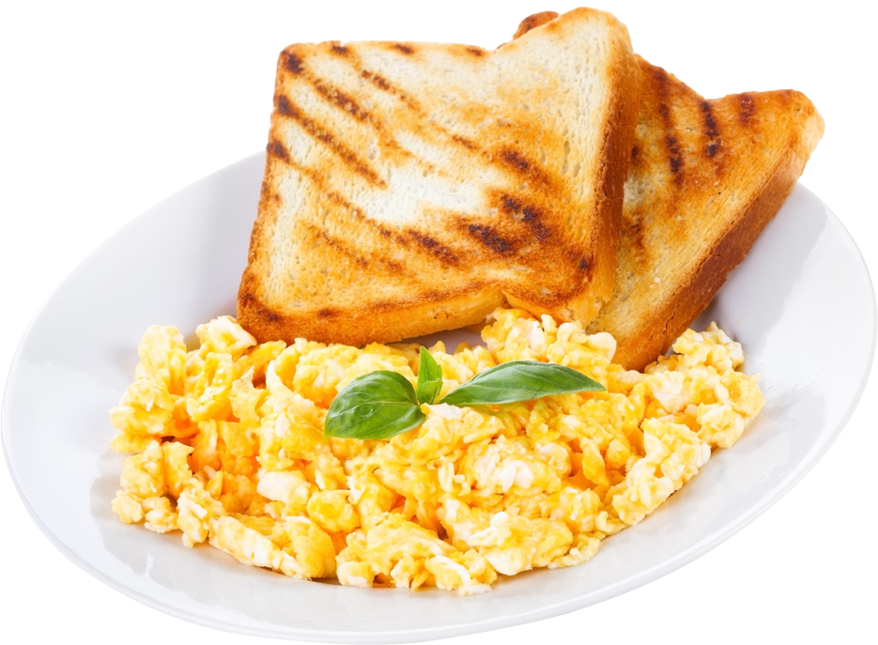
Strand 1
Recipes
Scrambled eggs

Slide 2
Preparation
Take off jewellery, tie back hair, put on apron and wash your hands. Gather equipment and ingredients. Set up table.
Ingredients
2 eggs
salt and pepper
2 tbsp milk
½ tsp butter
Sliced bread and butter, to serve
fresh parsley, to garnish
Equipment
bowls/plates
2 big plates – 1 for clean equipment and 1 for dirty equipment
1 tablespoon
1 teaspoon
1 knife
1 whisk
1 large saucepan
1 wooden spoon
1 small plate
1 pot stand

Slide 3
Method
Student A | Student B
Crack the eggs into bowl. Beat the eggs and add some seasoning. Toast the bread. Butter the bread. Serve scrambled eggs: Pile the eggs onto the toast. Garnish with parsley and serve immediately. | Melt the butter in a saucepan over a moderate heat. Add in the milk. Add the beaten eggs, stirring gently until they are thick, creamy and cooked through.
Together: Complete wash up. Tidy unit including sweeping the floor. | Complete your evaluation.

Slide 4
Evaluation
Colour?
Flavour?
Texture?
Presentation?
Cooked well?
Does the dish meet the brief?
Any changes for the future?
Notes:
Created the wordle myself

Slide 5
Link to Classroom-based assessment 2 (CBA 2)
Brief | Suitable
Healthy family meals to reflect the current healthy eating guidelines | ✓
A special dietary consideration or a diet-related disease | ✓
A particular stage of the lifecycle | ✓
A healthy homemade alternative to a commercial/takeaway meal | ✓
Resourceful cookery | ✓
A food enterprise or farmer’s market
Ethnic cookery

