Slide 1
Strand 2
Earthquakes part 2
Topic 23
Learning outcome 2.1: describe the economic and social impacts of how we interact with the occurrence of volcanoes, earthquakes and fold mountains

Slide 2
Earthquakes part 2
What will I learn?
How people are affected by earthquakes
The economic impact of earthquakes
How people respond to, and learn to live, with earthquakes
Key skills
Staying well by increasing my understanding that not all locations in the world are safe
Managing myself by making considered decisions about where I will travel

Slide 3
Earthquakes part 2
Why am I learning this?
To find out how earthquakes affect our lives in ways that are sometimes not obvious.
Success criteria
I understand how people are affected by earthquakes.
I can explain the economic impact of earthquakes.
I remember how people respond to and learn to live with earthquakes.

Slide 4
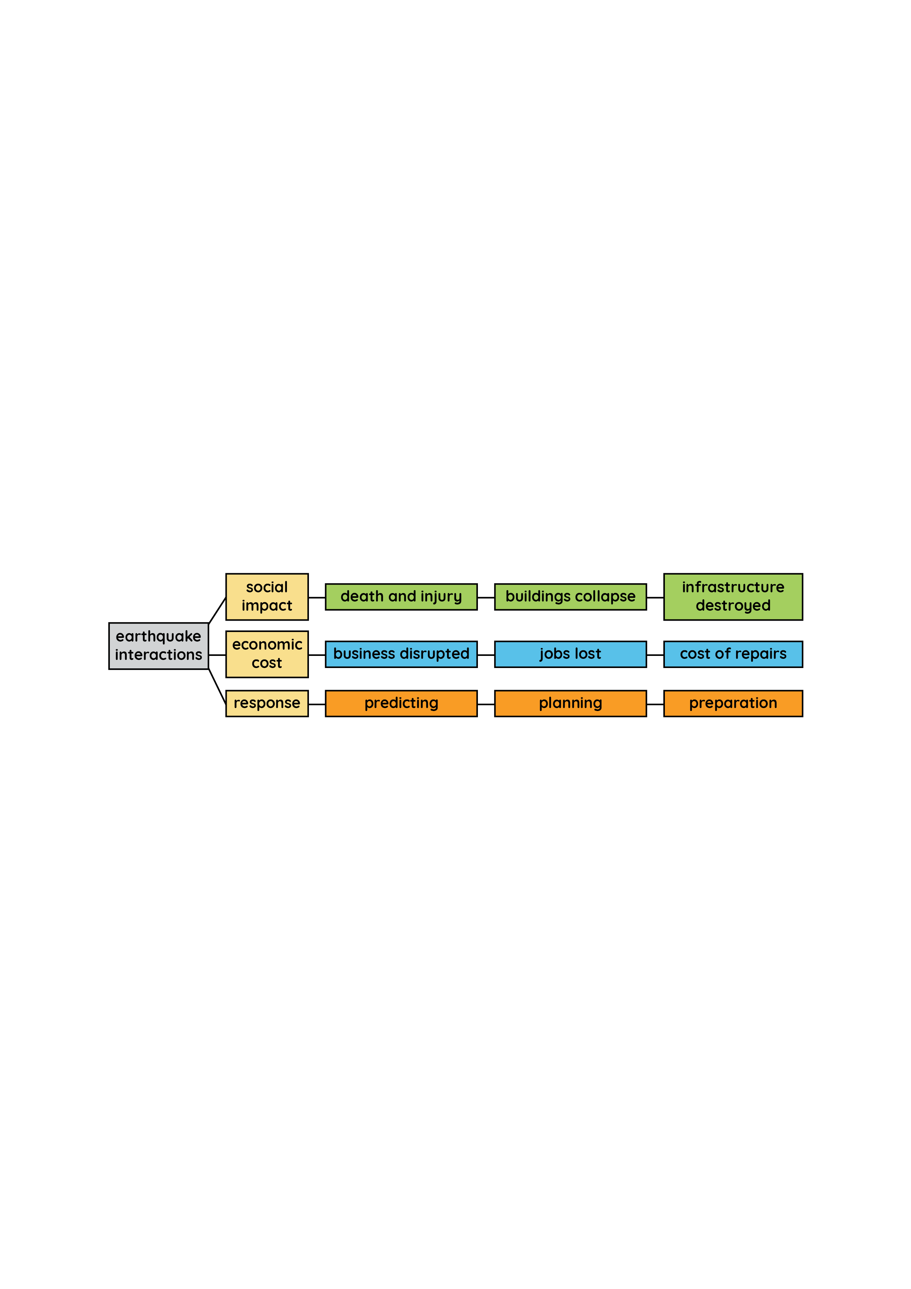
Earthquakes part 2
Keyword connections

Slide 5
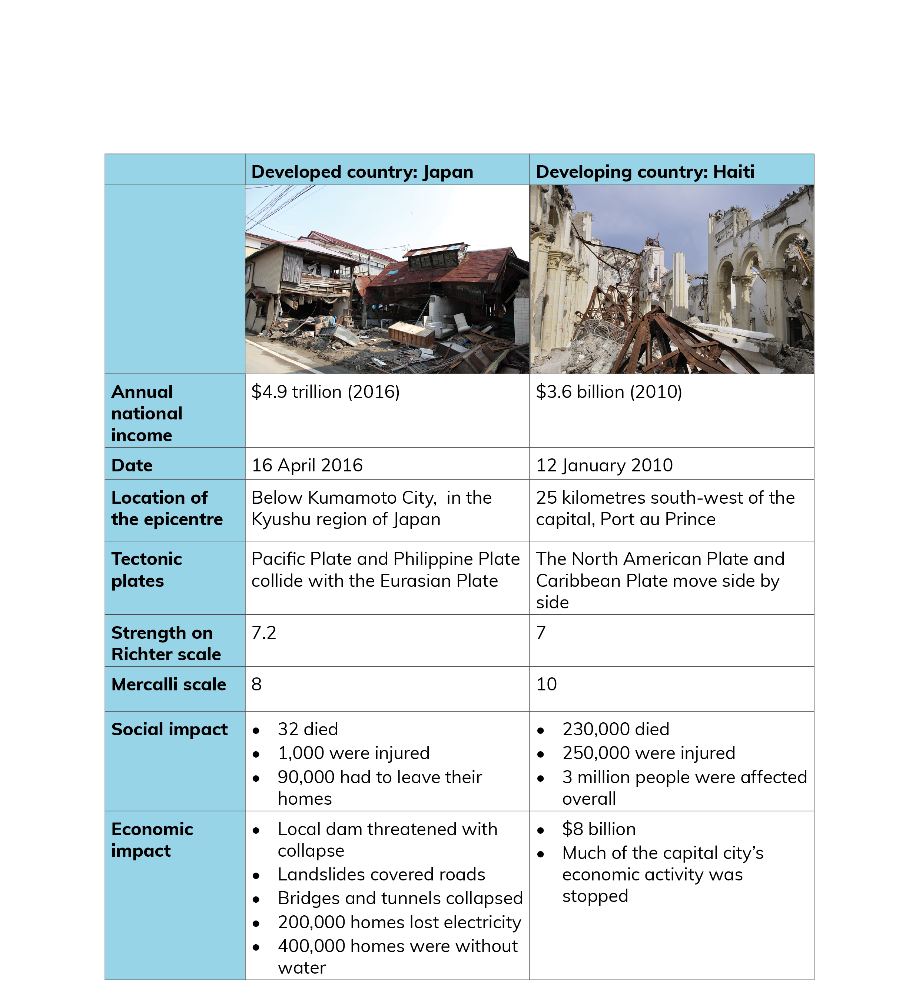
Earthquakes part 2
How earthquakes in one location are different to those in other locations

Slide 6
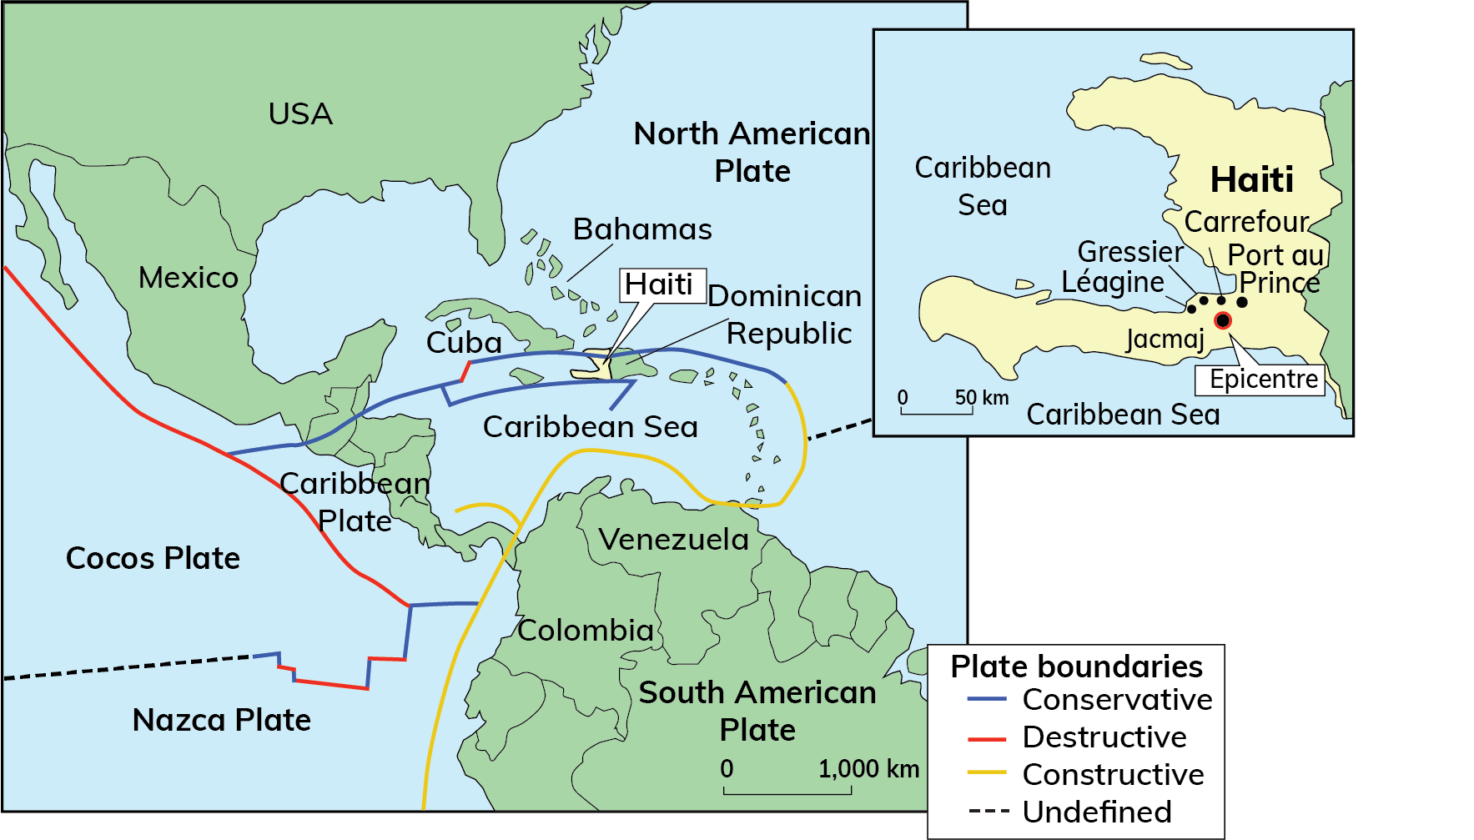
Earthquakes part 2
Real World Geography: Haiti earthquake, 12 January 2010
Haiti is located in the Caribbean.
It is a very poor country with a population of 10 million.
Its capital Port-au-Prince was struck by an earthquake that reached 7.0 on the Richter scale.
Much of the city was reduced to rubble.

Slide 7
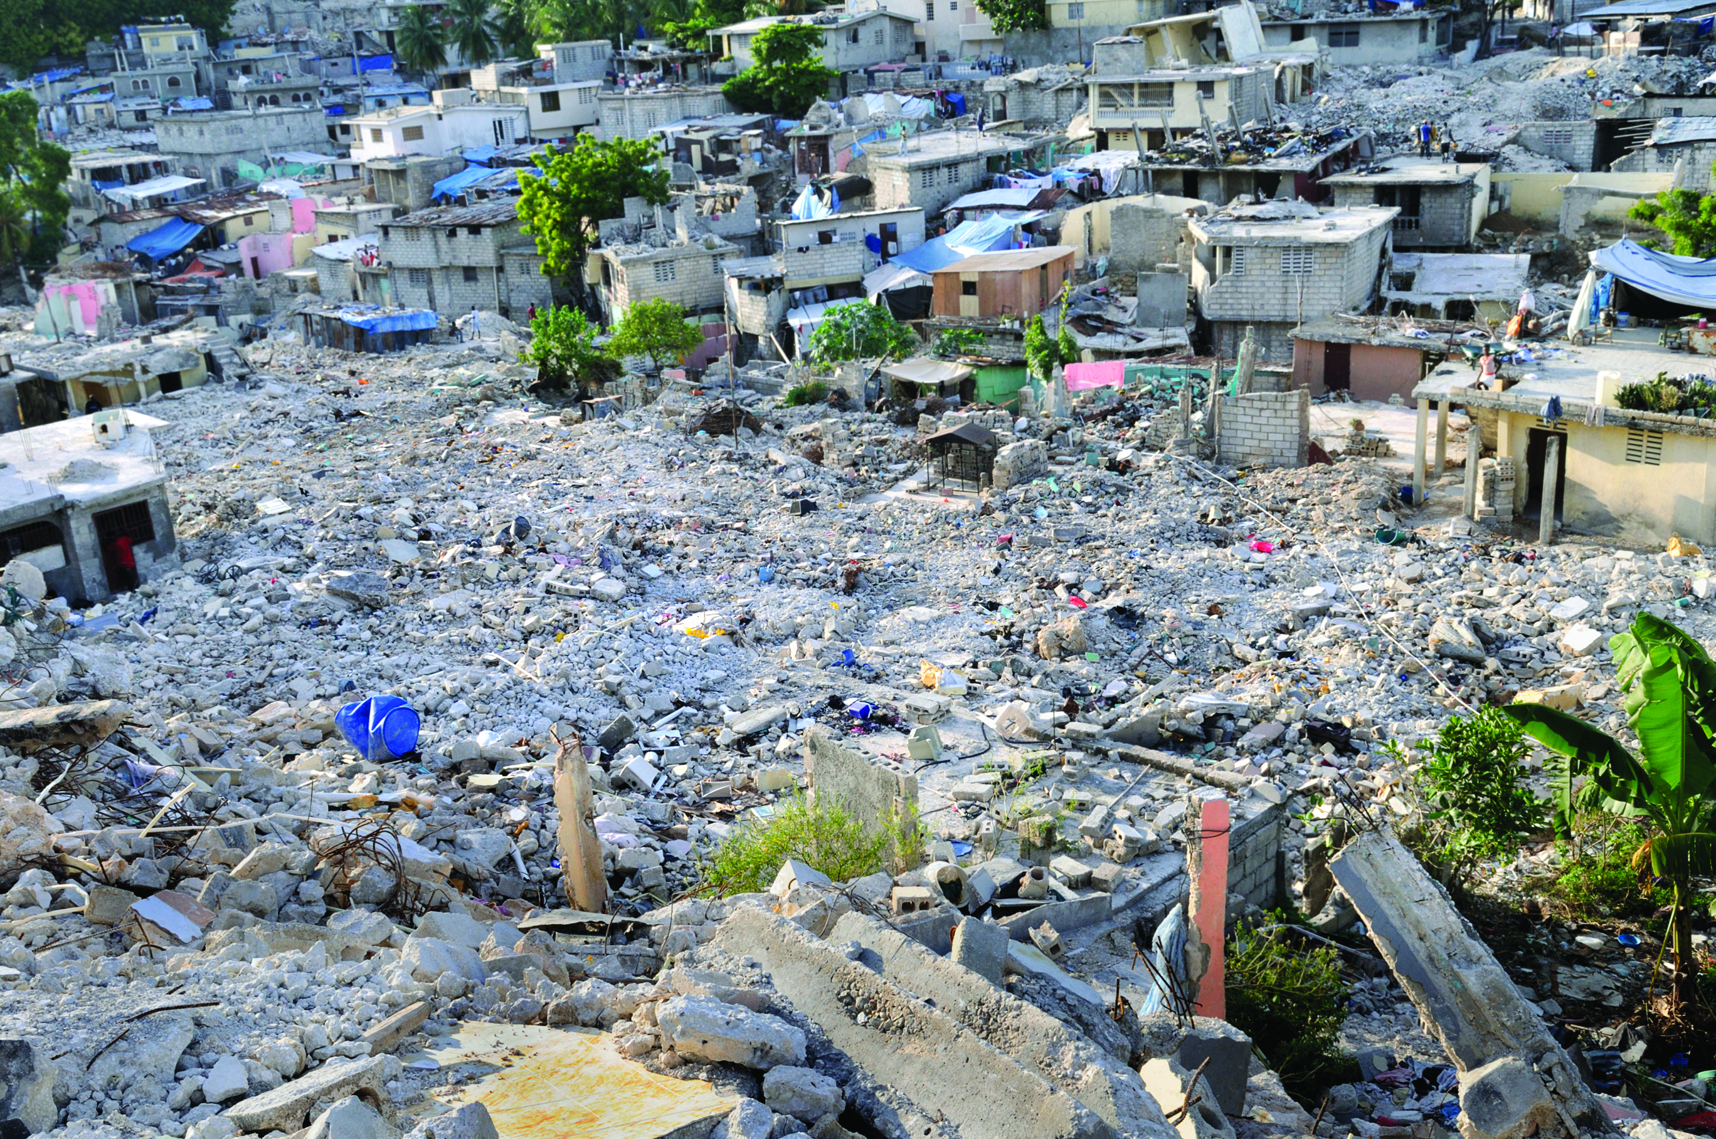
Earthquakes part 2
Real World Geography: Haiti earthquake, 12 January 2010
Look at this image of collapsed houses in Haiti.
Why do you think these houses collapsed?
What is the connection between the quality of buildings and earthquake damage?

Slide 8
Earthquakes part 2
Real World Geography: Haiti earthquake, 12 January 2010
Social impact
Poorly constructed houses collapsed and one million people were left homeless.
230,000 people were killed.
All Haiti’s hospitals were damaged or destroyed.
A prison was destroyed, releasing 4,000 inmates.
Water, electricity and sewerage systems were damaged.
Poor sanitation led to an outbreak of waterborne diseases, e.g. cholera.
Seaport and airport were destroyed, delaying aid agencies offering help.
Violence and looting broke out.

Slide 9
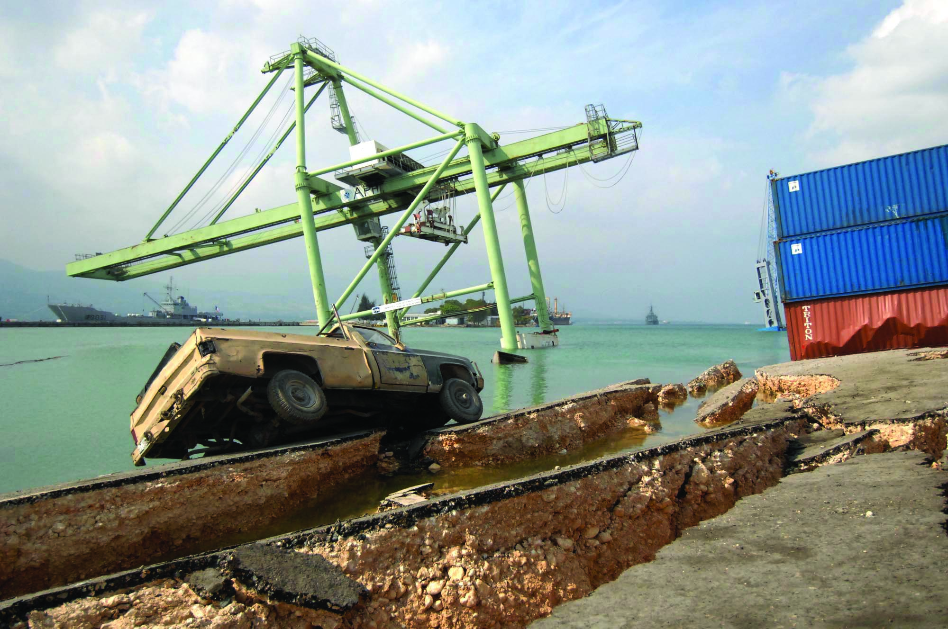
Earthquakes part 2
Real World Geography: Haiti earthquake, 12 January 2010
Look at the image below showing Haiti’s main port at Port-au-Prince after the earthquake.
Describe the damage shown in the photograph.
What were the implications of the destruction of the port for Haiti?

Slide 10
Earthquakes part 2
Real World Geography: Haiti earthquake, 12 January 2010
Economic impacts
Seaport and airport were destroyed, key communication links.
Roads were blocked which lead to difficulties getting aid in.
Important historical buildings were destroyed, e.g. National Palace.
250,000 homes and 30,000 commercial buildings were destroyed.
The UN appointed Bill Clinton, former US President, to coordinate relief efforts that would be needed for many years, to not only rebuild the country's infrastructure but also its economic development.

Slide 11
Earthquakes part 2
Responding to the effects of earthquakes
Short-term effects
Deaths and injuries
Buildings – homes, offices, factories – are damaged and collapse
Infrastructure disrupted or destroyed – water and sewerage pipes burst, electricity and telephone cables snap, gas pipes break, causing fire
Roads crack and collapse, railway lines bend, harbour walls break
Cost of emergency aid

Slide 12
Earthquakes part 2
Responding to the effects of earthquakes
Long-term effects
Bereavement as people live with the loss of loved ones
Fear as people live with the uncertainty of future earthquakes
Jobs lost as businesses are disrupted
Homelessness while people await the reconstruction of their homes
Homes, factories and offices need services to be repaired – this takes time
Roads need to be reconstructed
Cost of repairs take money from other services

Slide 13
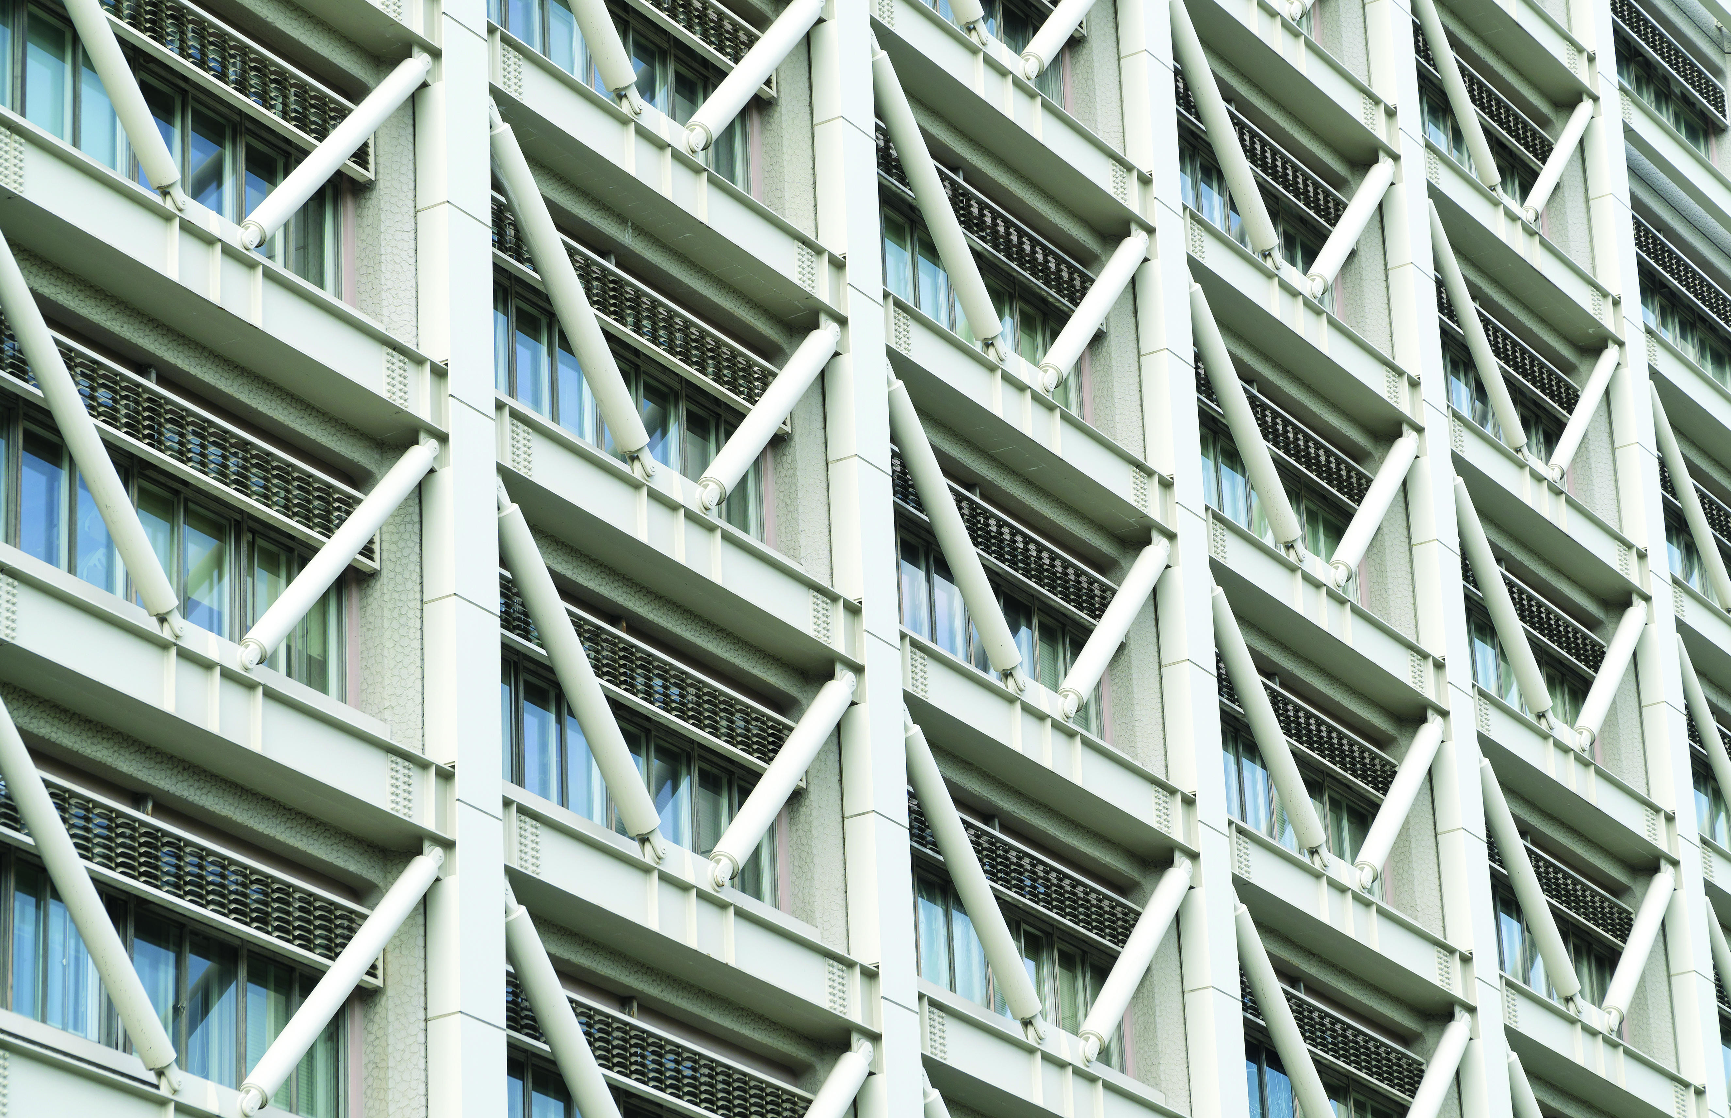
Earthquakes part 2
Responding to the effects of earthquakes
Predicting earthquakes: We can predict where earthquakes can occur, e.g. plate boundaries, but we cannot predict when. Laser monitoring ground movement, the release of radon gas and animal behaviour are all used to try to predict earthquakes.
Planning: Government help to limit the effects of earthquakes by strict planning laws, e.g. earthquake-proof building regulations.
Preparation: In Japan schoolchildren have ‘duck, cover and hold’ routines and most governments organise search-and-rescue personnel with trained sniffer dogs. Emergency supplies are on hand in these areas as well.

