Slide 1
PowerPoint Exemplar

Slide 2
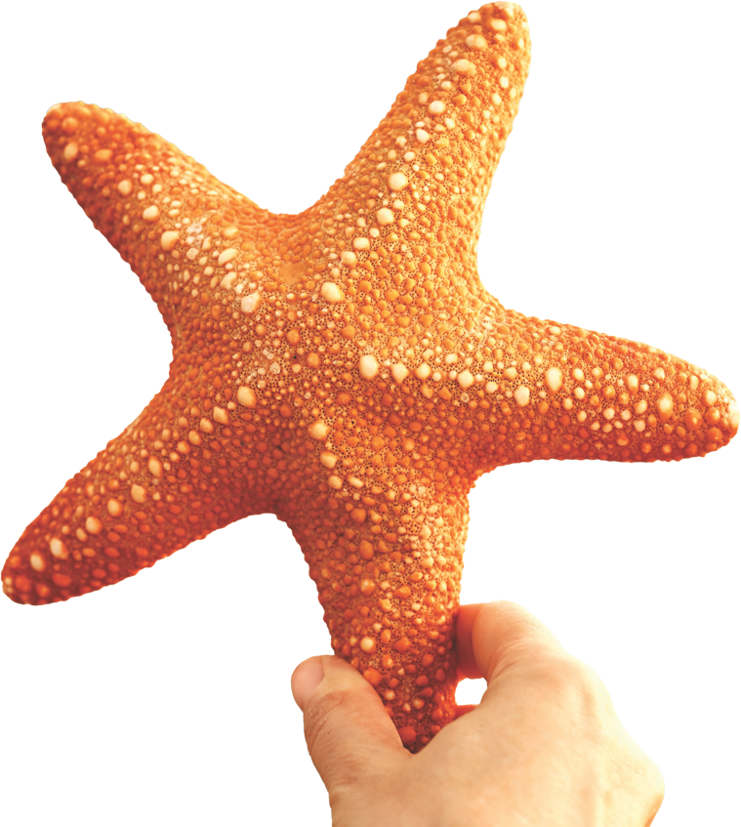
Lesson 18: Racism
We all belong to a single species – the human race

Slide 3
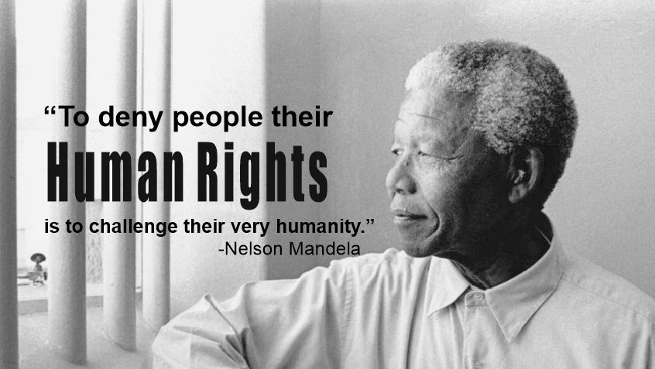
Chapter
03

Slide 4
Racism: What is it?
Chapter
03
Racism is a denial of human rights.
Human Rights are universal (for EVERYONE), are inalienable (CANNOT be given or taken away) are indivisible (we are entitled to ALL of them). Racism is a denial of human rights.
Racism is a form of prejudice. It is rooted in a negative attitude to people because of their race, religious beliefs or ethnicity. It leads to discrimination, which is unfair actions based on prejudice.
Racism is described as the abuse of power against people because of who they are, what they believe, their cultural or national origins, or the colour of their skin.
Racism is at individual level when individuals are the target, at institutional level when a society operates to exclude a group of people, or at ideological level when people have the idea that they are somehow superior.

Slide 5
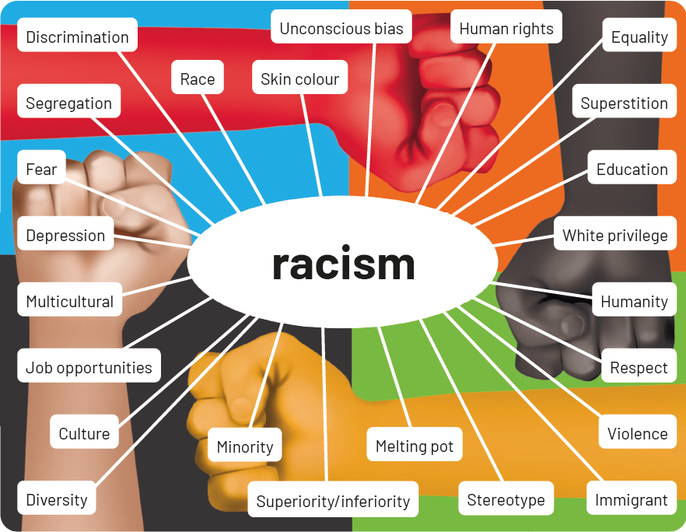
What does this image say about racism?
Chapter
03

Slide 6
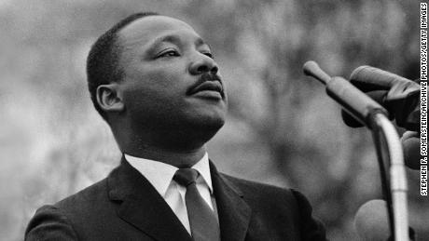
Sadly, racism is nothing new …
Chapter
03
Throughout time, there have been people who were enslaved by other people. History tells a story of the abuse of power down through the ages.
Slavery, apartheid, persecution, pogroms, genocide, bondage, white supremacy are words that tell the story of racism.
There have been champions who took a stand and fought against racism. Like Abraham Lincoln who freed the slaves in America in 1865, or Martin Luther King Jr., who made the famous ‘I have dream’ speech.
What is your dream for the world?
I have a dream ...

Slide 7
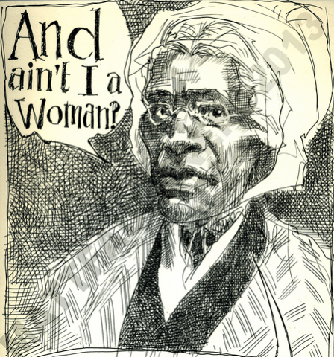
Read another famous speech — by Sojourner Truth
Chapter
03
“Dat man ober dar say dat womin needs to be helped into carriages, and lifted ober ditches, and to hab de best place everywhar. Nobody eber helps me into carriages, or ober mud-puddles, or gibs me any best place!”…“And a’n’t I a woman? Look at me! Look at my arm! I have ploughed, and planted, and gathered into barns, and no man could head me! And a’n’t I a woman? I could work as much and eat as much as a man—when I could get it—and bear de lash as well! And a’n’t, I a woman? I have borne thirteen chilern and seen ’em mos’ all sold off to slavery, and when I cried out with my mother’s grief, none but Jesus heard me! And a’n’t I a woman.”
Sojourner was born into slavery in 1797 and later freed.

Slide 8

Black Lives Matter (BLM) movement
Chapter
03
Three woman, Patrisse Khan-Collors, Alicia Garza and Opal Tometi founded the Black Lives Matter movement in July 2013, when they began to use the hashtag #BlackLivesMatter on social media after the man responsible for shooting Trayvon Martin (aged 17), George Zimmerman, was allowed to go free.
The movement really hit the headlines after the killing of George Floyd by a Minneapolis police officer.
BLM is now a global organization which works for a world where black lives are no longer targeted. The BLM movement is one of the largest protest movements that the world has ever seen. The BLM campaign is not over.

Slide 9
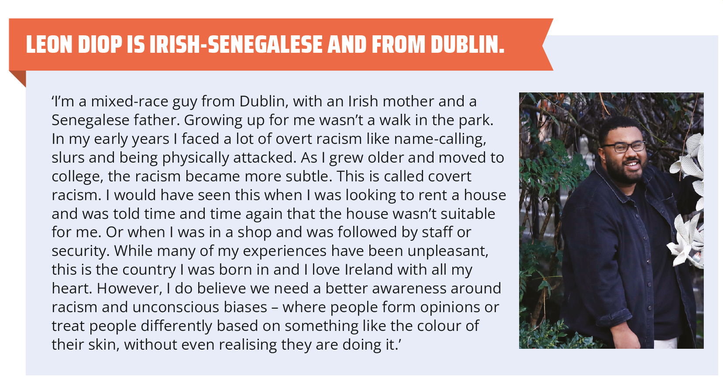
Black Lives Matter (BLM) in Ireland
Chapter
03

Slide 10
What is this image saying?
Chapter
03

Slide 11
What is this image saying?
Chapter
03

Slide 12
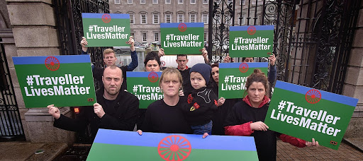
Where is Racism to be found?
Chapter
03
Where do you find Racism?
Everywhere!
Don’t forget that discrimination against the Travelling community in Ireland is RACISM
How does it look…
In sport?
In the workplace?
In shops?
In schools?
On the streets?
On social media?

Slide 13
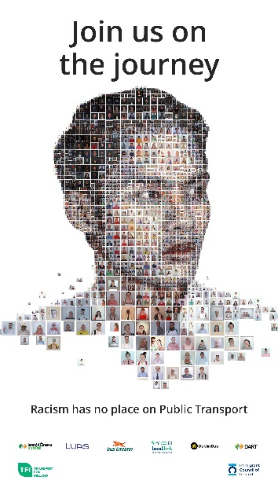
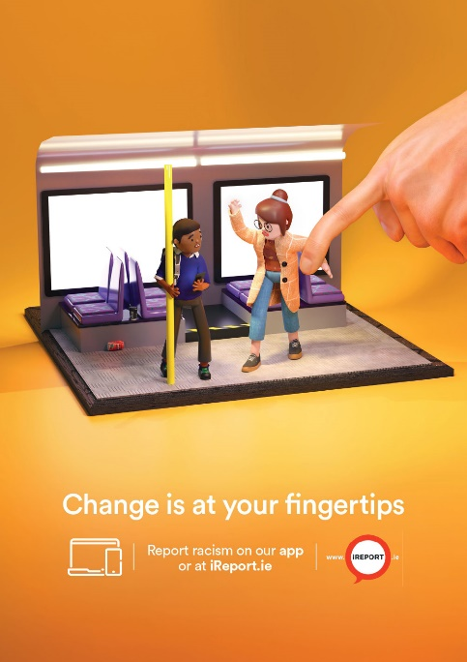
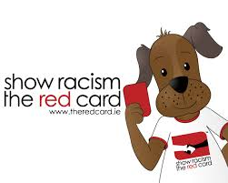
Tackling Racism
In Ireland race, religion, and membership of the travelling community are 3 of the 10 grounds of discrimination. The Equal Status Act prohibits this.
In a world that believes in human rights, that values equality and diversity, there have been serious efforts to stamp out racism and never, ever to excuse racist behaviour or language.
Chapter
03

Slide 14
How could we as a CSPE class celebrate No Racism Day in our school?
Chapter
03

