Slide 1
Chapter 19: Statistics II Exercises and Revision Questions

Slide 2
Table of Contents
Exercise 19.1
Exercise 19.2
Exercise 19.3
Exercise 19.4
Exercise 19.5
Exercise 19.6
Exercise 19.7
Revision Exercises

Slide 3
Exercise 19.1

Slide 4
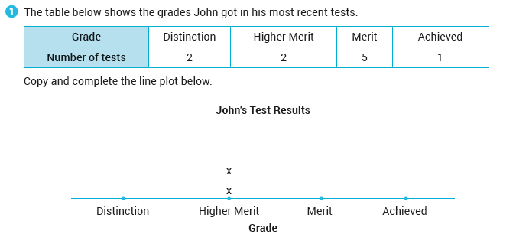
Exercise 19.1
Back to table of contents

Slide 5
Exercise 19.1
Back to table of contents

Slide 6
Exercise 19.1
Back to table of contents

Slide 7
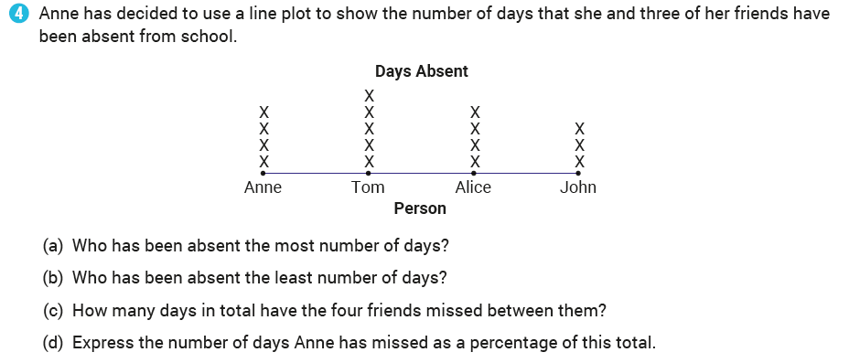
Exercise 19.1
Back to table of contents

Slide 8
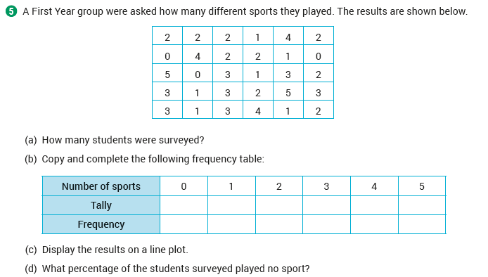
Exercise 19.1
Back to table of contents

Slide 9
Exercise 19.2

Slide 10
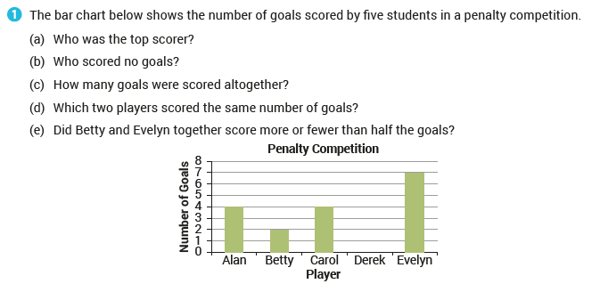
Exercise 19.2
Back to table of contents

Slide 11
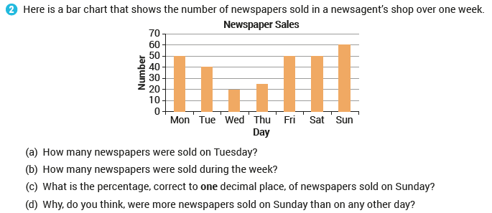
Exercise 19.2
Back to table of contents

Slide 12
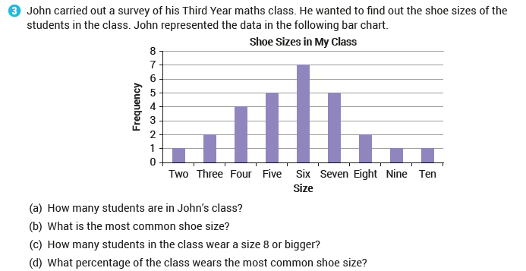
Exercise 19.2
Back to table of contents

Slide 13
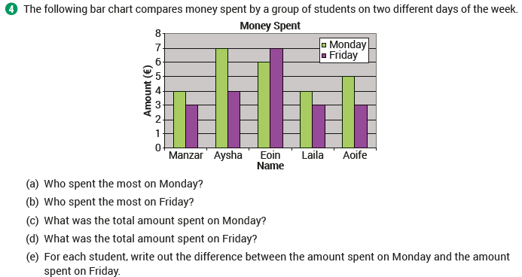
Exercise 19.2
Back to table of contents

Slide 14
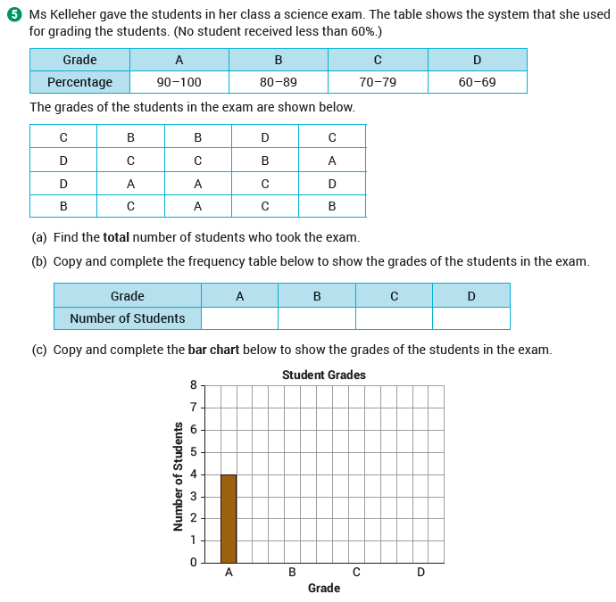
Exercise 19.2
Back to table of contents

Slide 15
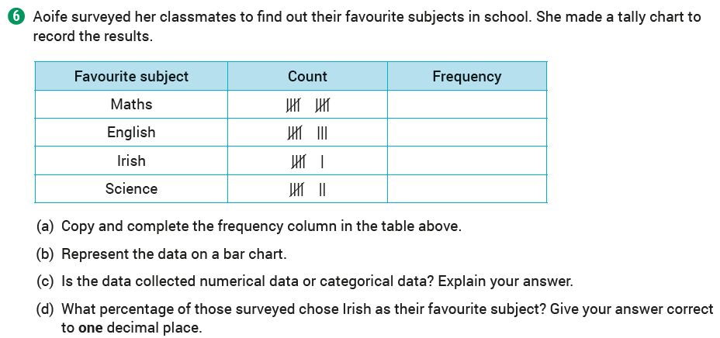
Exercise 19.2
Back to table of contents

Slide 16
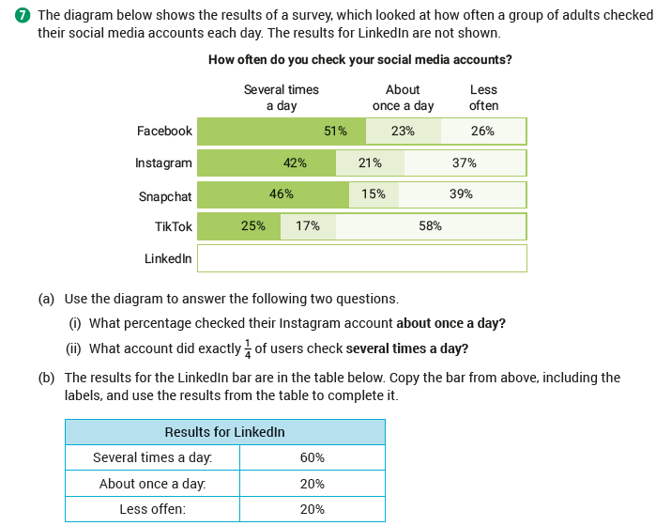
Exercise 19.2
Back to table of contents

Slide 17
Exercise 19.3

Slide 18
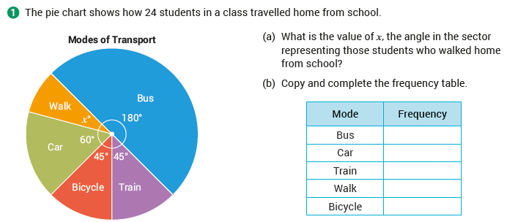
Exercise 19.3
Back to table of contents

Slide 19
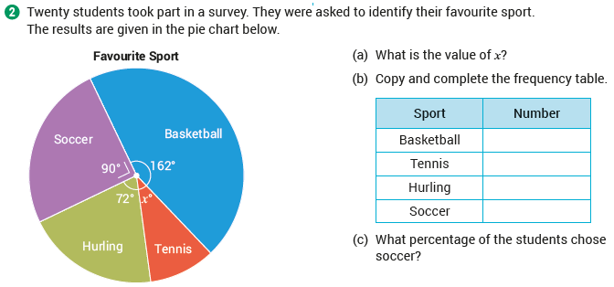
Exercise 19.3
Back to table of contents

Slide 20
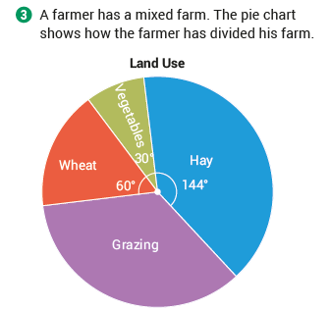
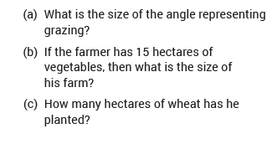
Exercise 19.3
Back to table of contents

Slide 21
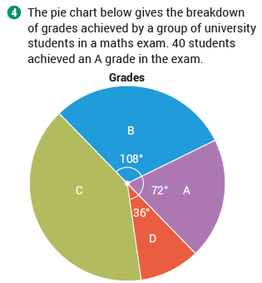
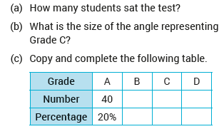
Exercise 19.3
Back to table of contents

Slide 22
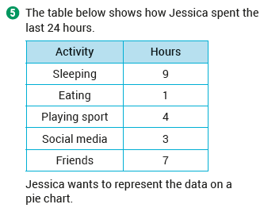
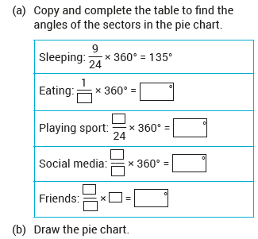
Exercise 19.3
Back to table of contents

Slide 23
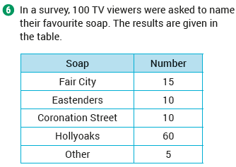
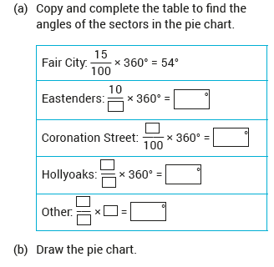
Exercise 19.3
Back to table of contents

Slide 24
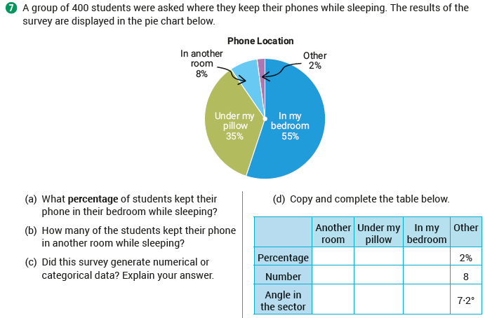
Exercise 19.3
Back to table of contents

Slide 25
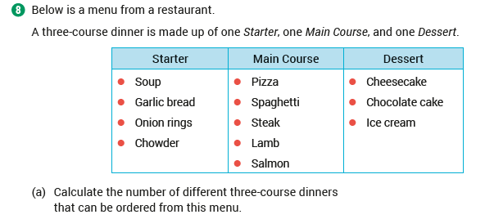
Exercise 19.3
Back to table of contents

Slide 26
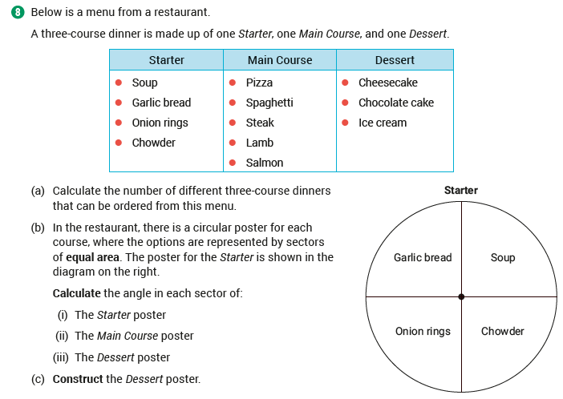
Exercise 19.3
Back to table of contents

Slide 27
Exercise 19.4

Slide 28
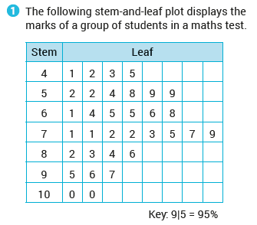
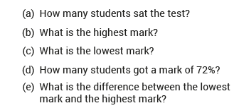
Exercise 19.4
Back to table of contents

Slide 29
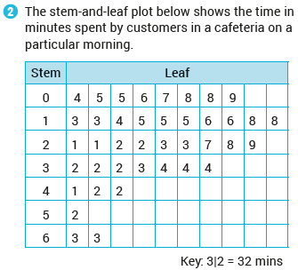
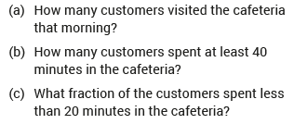
Exercise 19.4
Back to table of contents

Slide 30
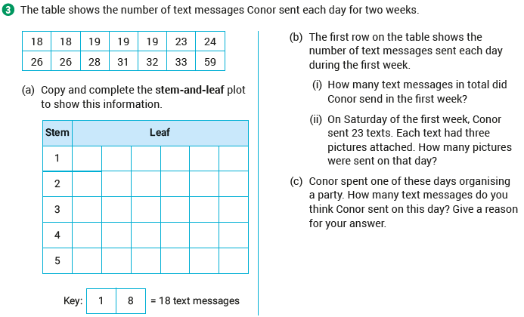
Exercise 19.4
Back to table of contents

Slide 31
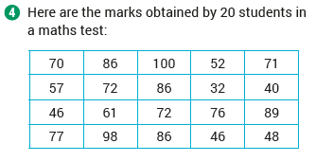
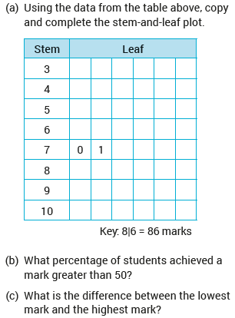
Exercise 19.4
Back to table of contents

Slide 32
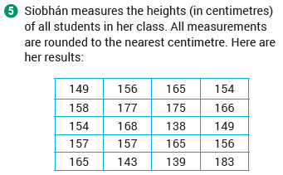
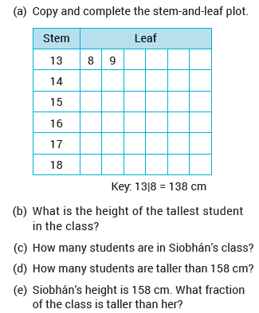
Exercise 19.4
Back to table of contents

Slide 33
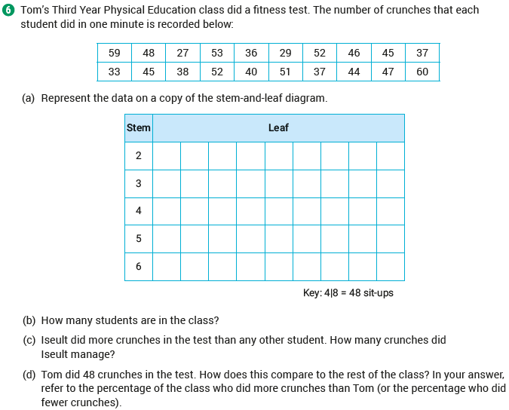
Exercise 19.4
Back to table of contents

Slide 34
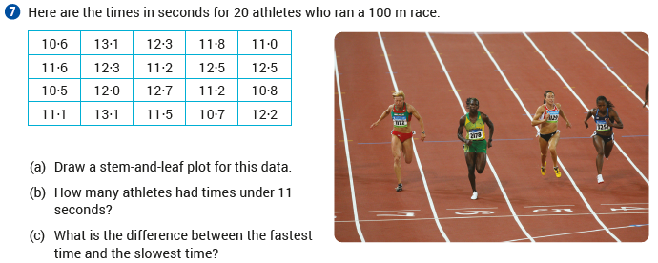
Exercise 19.4
Back to table of contents

Slide 35
Exercise 19.4
Back to table of contents

Slide 36
Exercise 19.5

Slide 37
Exercise 19.5
Back to table of contents

Slide 38
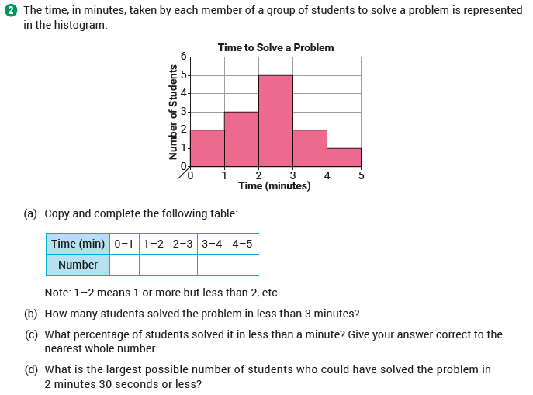
Exercise 19.5
Back to table of contents

Slide 39
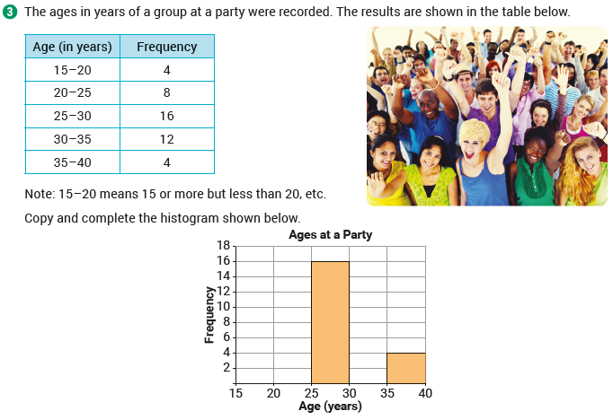
Exercise 19.5
Back to table of contents

Slide 40
Exercise 19.5
Back to table of contents

Slide 41
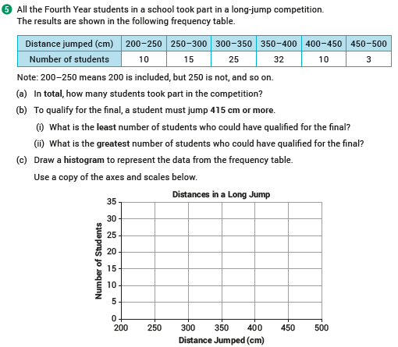
Exercise 19.5
Back to table of contents

Slide 42
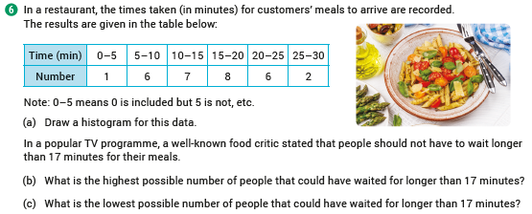
Exercise 19.5
Back to table of contents

Slide 43
Exercise 19.6

Slide 44
Exercise 19.6
Back to table of contents

Slide 45
Exercise 19.6

Slide 46
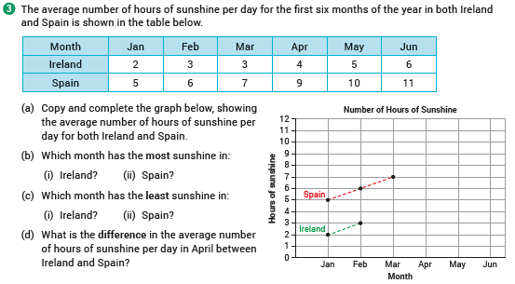
Exercise 19.6

Slide 47
Exercise 19.6

Slide 48
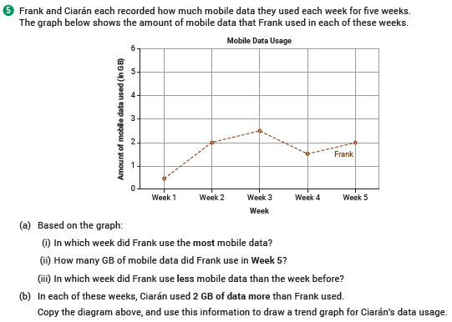
Exercise 19.6
Back to table of contents

Slide 49
Exercise 19.7

Slide 50
Exercise 19.7
Back to table of contents

Slide 51
Exercise 19.7
Back to table of contents

Slide 52
Exercise 19.7
Back to table of contents

Slide 53
Exercise 19.7
Back to table of contents

Slide 54
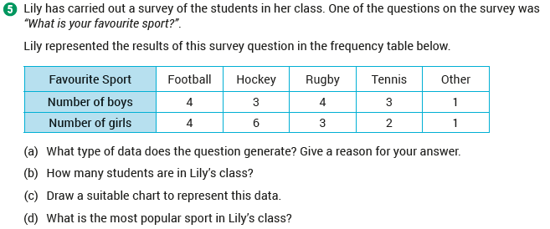
Exercise 19.7
Back to table of contents

Slide 55
Revision Exercises

Slide 56
Revision Exercises
Back to table of contents

Slide 57
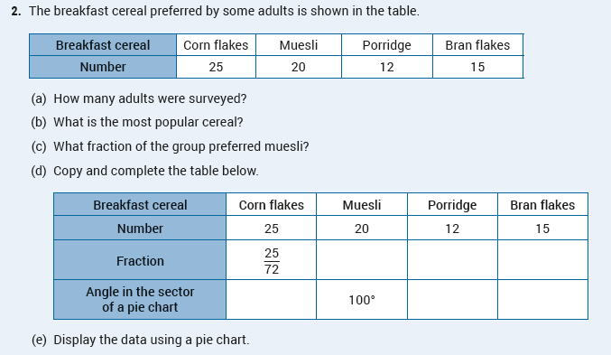
Revision Exercises
Back to table of contents

Slide 58
Revision Exercises
Back to table of contents

Slide 59
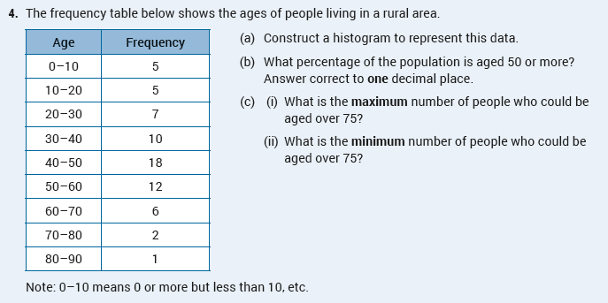
Revision Exercises
Back to table of contents

Slide 60
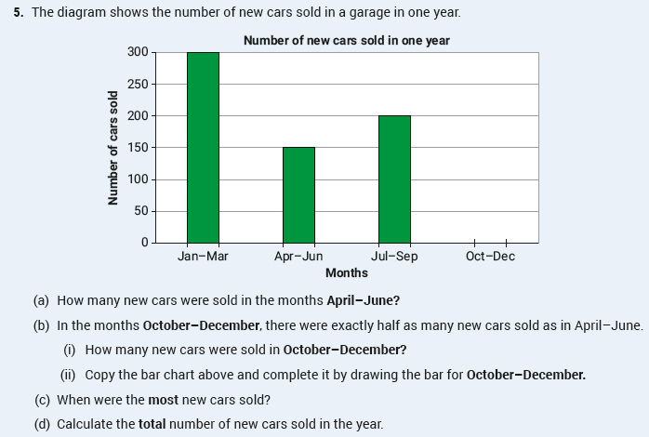
Revision Exercises
Back to table of contents

Slide 61
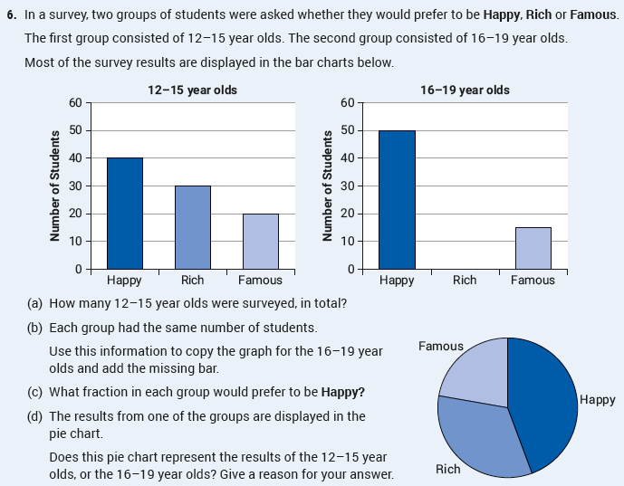
Revision Exercises
Back to table of contents

Slide 62
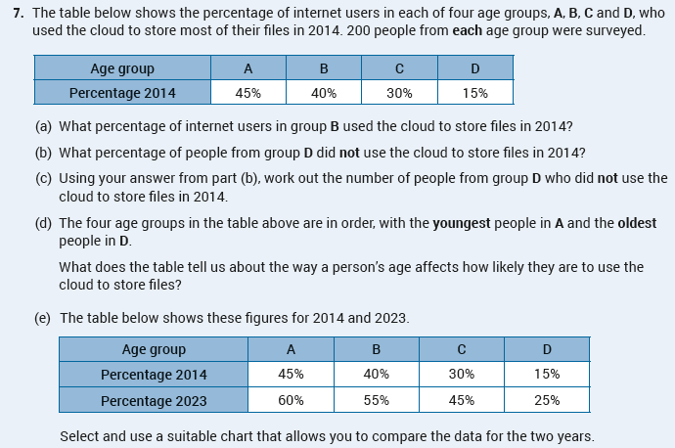
Revision Exercises
Back to table of contents

