Slide 1
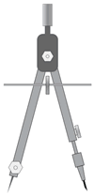
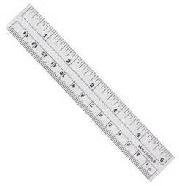
5
Construction 8
Line Segment of a Given Length on a Given Ray
Construct a line segment 5 cm in length on the given ray.
Draw a ray through the two points X and Y, starting at X.
Using a ruler, draw [EF] of length 5 cm.
Place the compass needle point on the point E. Adjust the compass width until it is at point F, i.e. the compass width is 5 cm.
Using this compass width, place the compass needle point on the point X.
Without adjusting the compass width, draw an arc that crosses the ray. Label this point of intersection as Z.
E
5 cm
F
Ray
X
5 cm
Z
Y

