Slide 1
Teaching Techniques for The JC Business Studies Exam

Slide 2
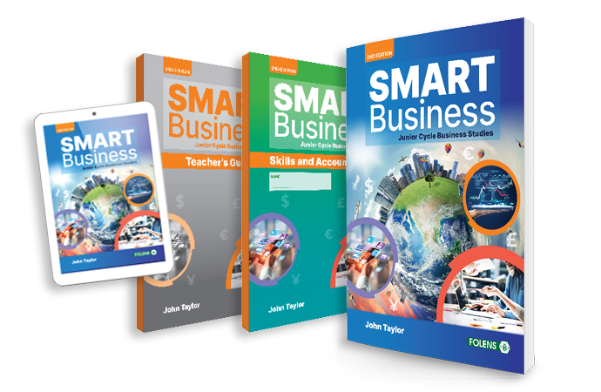
Check out the books and digital resources on Folens.ie!

Slide 3
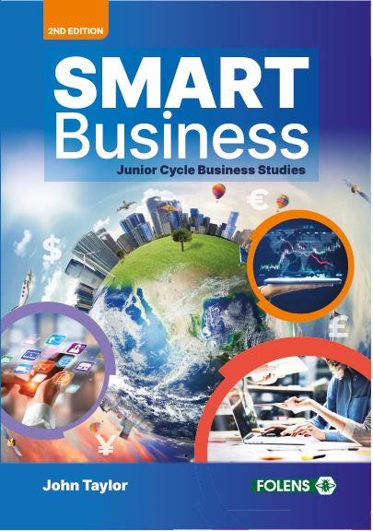
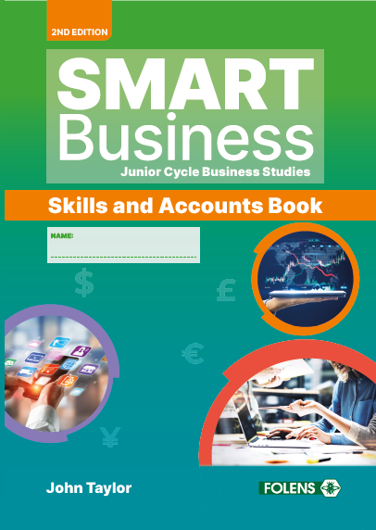
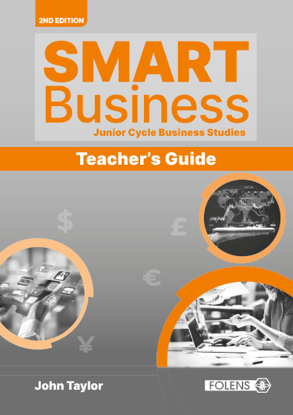
The SMART Business Teaching Package
Print:
Textbook
Skills & Accounts Book
Teacher’s Guide
Digital resources:
Student ebook
PowerPoints
Bookkeeping videos
Termly exams
Weblinks

Slide 4
The SMART Business Approach
Teaching, learning, revision
- Chapters structured by learning goal
- Chapter summaries
- End-of-chapter revision
Exam focus
- Exam chapter
- Exam-style questions
CBA support
- Textbook sections
- Skills and Accounts Book sections
Planning
- Schemes of work
- Lesson plans

Slide 5
Exam Technique:
2023 Paper - What we should learn from it
Interpreting Command Verbs
Common Errors Made & Break down of Marks
How to Approach Exam Style Answers
Revision Techniques

Slide 6
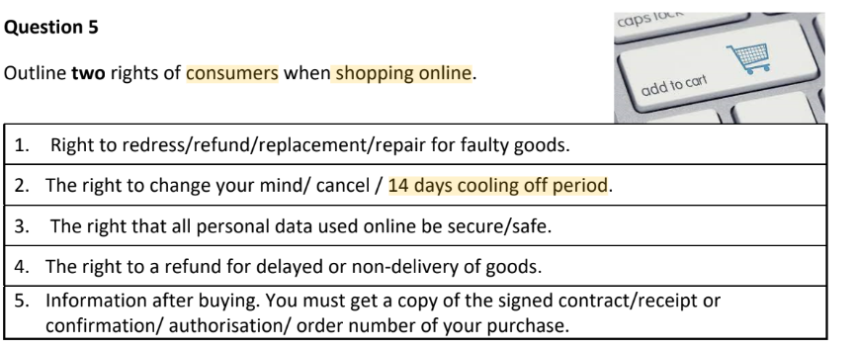
Be specific…
Notes:
Discuss the need to refer to specific examples, local or specific key terms in their answers

Slide 7
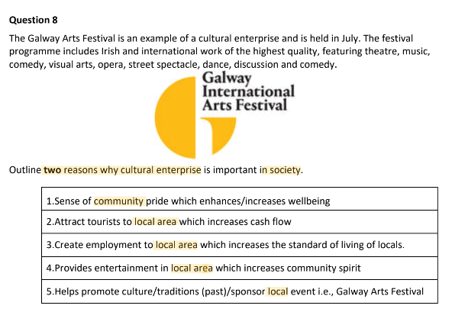
Be specific…

Slide 8
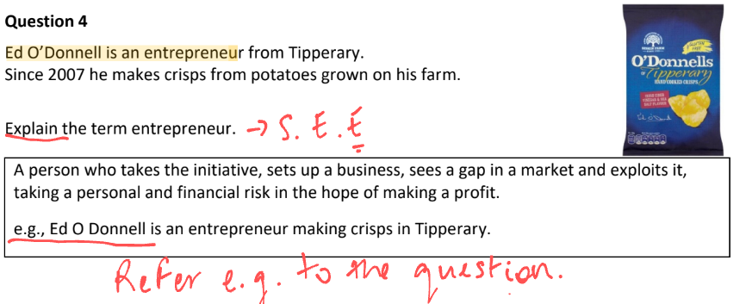
Be specific… refer to the question

Slide 9
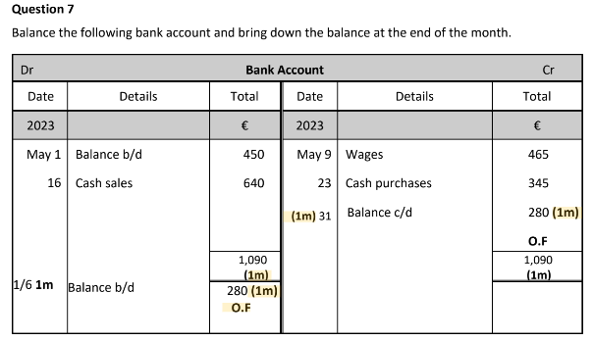
Accounting Topics
Double Entry
Notes:
Alternating one topic a week between Easter and the exam of the accounting topics

Slide 10
Q17 - Final Accounts
Template is needed - teaching section by section
Workings are important - Depreciation

Slide 11
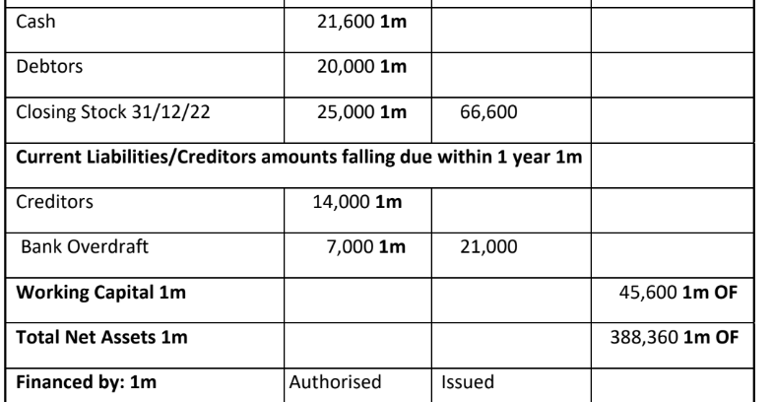
Final Accounts
Marks are awarded for headings, slightly more specific than last year -
Acceptable headings - i.e Current Liabilities falling due within one year
Need to label authorised vs issued share capital

Slide 12
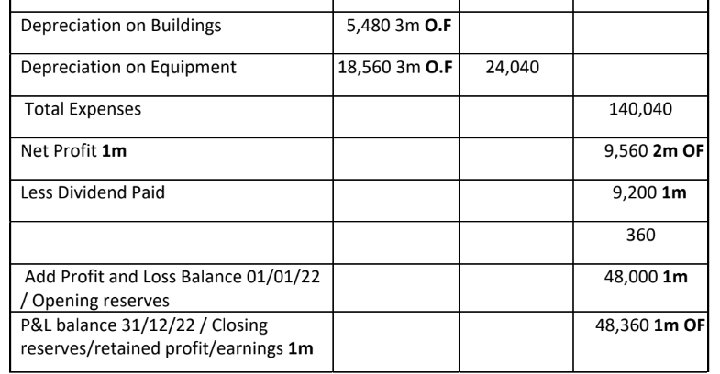
Final Accounts
Notes:
Showing depre separately
Acceptable headings

Slide 13
Explain
Distinguish
Key term / definition
Two pieces of info
SEE method
DIfference between
Two definitions
Clarify with examples
Describe
Outline
Explain
Advantages / Disadvantages
Refer to Qs & give example
Impacts / effects / affects
State
Explain
Expand - explain the impact

Slide 14
Identify
Classify
Brief explanation
Full sentence
Into categories
e.g. expenses
Illustrate
SEE Method
Explain with an example
Diagram / Graph
State
Explain
Example

Slide 15
Most common approach:
S - STATE
E - EXPLAIN E - EXAMPLE

Slide 16
Mark Breakdown
All or nothing | Partial Marks
Order of Business Document Explain - 3m or 0m | Explain - 3m or 1m MCQs - decreasing marks e.g. 4m, 1m, 1m
Use the space given
Notes:
DO not write outside, only use a pen, blue / black as much as possible

Slide 17
Calculations: Forgetting the € sign - 1m lost or no workings
Graphs: Interpreting graphs/labelling
Misreading the graph/question i.e. Drop in unemployment = higher employment, Impact on (consumer, business, society etc)
Supply & Demand - labelling both the axis, the supply and demand curves
Common Errors
Loss of Marks

Slide 18
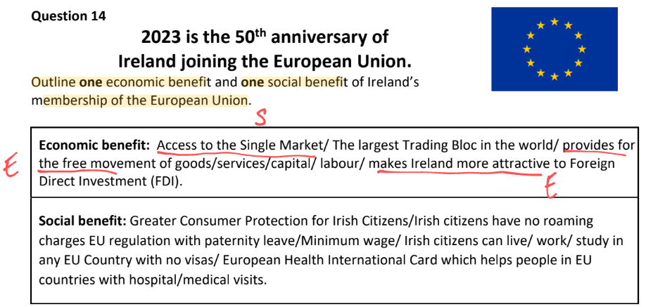
Exam Style Answers
Outline -

Slide 19
Exam Style Answers
Differentiate -

Slide 20
Exam Style Answers
Explain

Slide 21
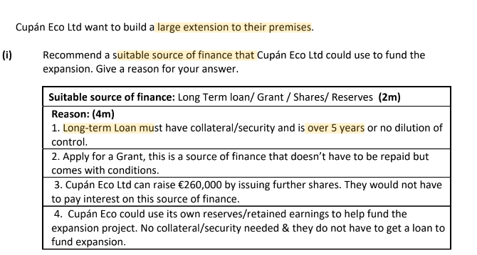
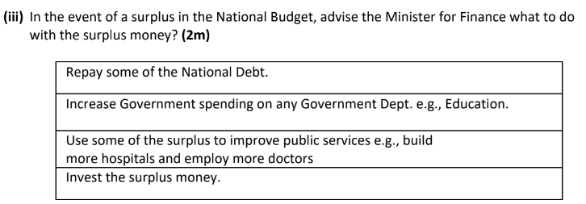
Exam Style Answers
Recommend

Slide 22
Revision Tips
Key terms - quizlet, definition dots, summary of chapters, success criteria
Take an accounting topic a week
Review formulas and calculations
Link chapters - refresher questions in tests
Exam question practice
Notes:
mine and pages oin the book

Slide 23
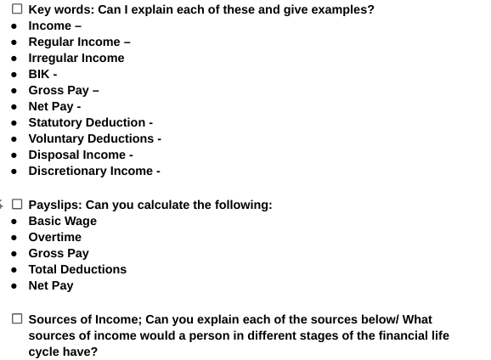
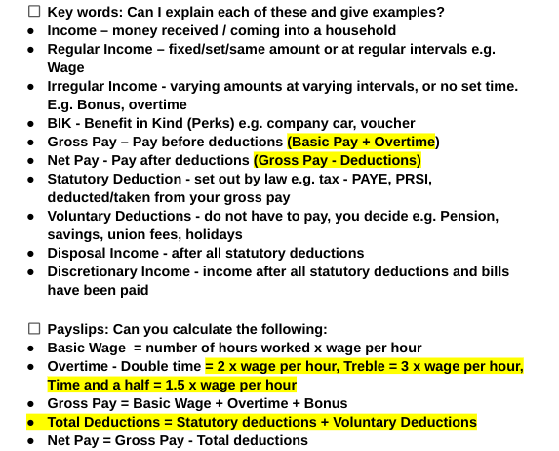
Success Criteria Example:

Slide 24
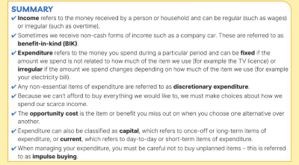
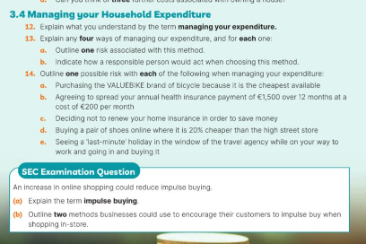

Slide 25
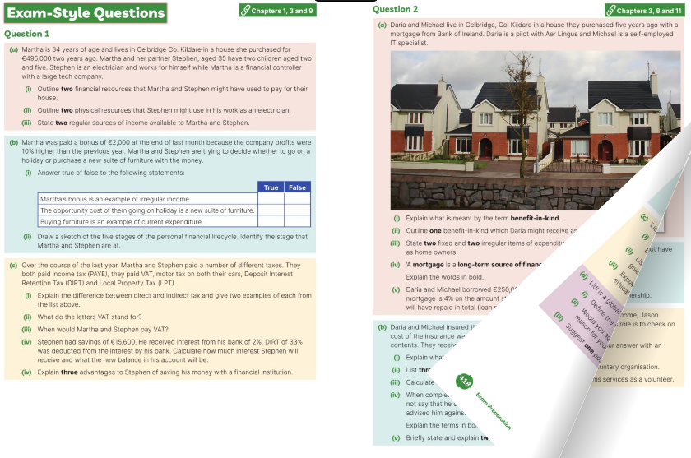
Exam question practice
Notes:
Questions in the book in exam section

Slide 26
Your local Folens Rep
Available for calls or appointments at a time that suits you
Can arrange samples
Support for new JC book scheme
Find your Rep on Folens.ie!

Slide 27
Q&A

Slide 28
Thank you!

