Slide 1
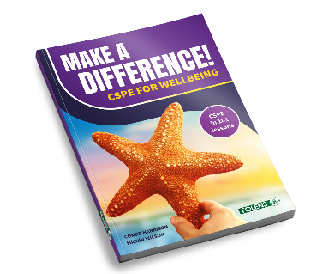
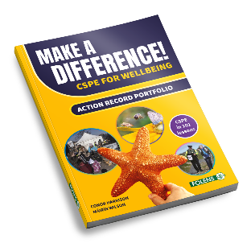
CSPE
Action & Assessment
CH & MW
Conor Harrison & Máirín Wilson
Wednesday, 13th March 2024

Slide 2
By the end of this webinar, you will:
- not be confused(!) about the CSPE short course requirements
- know how CSPE fits into Wellbeing
- have a broad understanding of the three CSPE strands
- know how to engage your students in active learning
- know how to support actions to foster student agency
- be informed about CSPE assessment, the Action Record and CBA
CH & MW
Learning Intentions

Slide 3
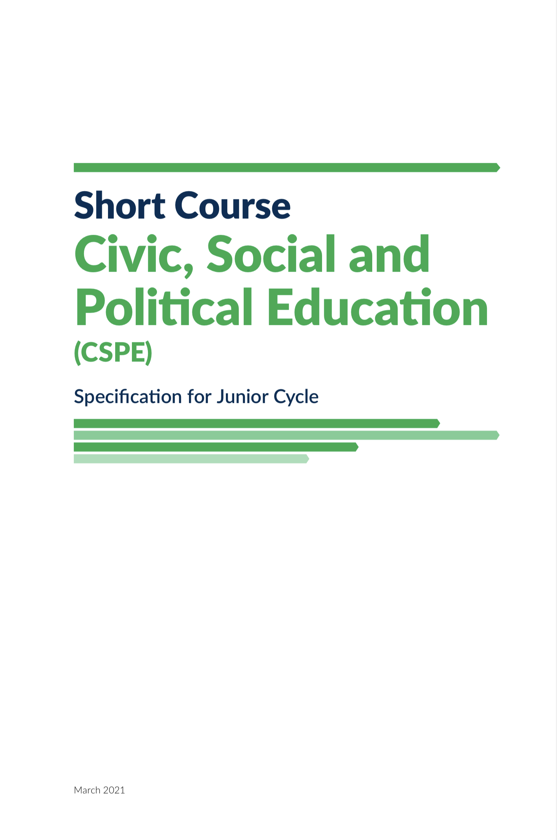

CH
What about CSPE within Wellbeing?
The ‘Well Citizen’
Distinct Area of study (100 hours)
Circular 0076/2020
Circular 0028/2023
CSPE Specification, March 2021
Wellbeing Guidelines, March 2021
Wellbeing Indicators
Key Skills Checklists
Literacy and Numeracy

Slide 4
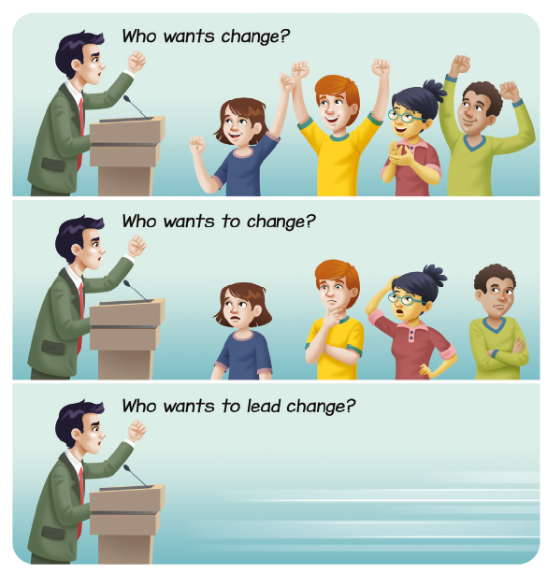
CH
The ‘Well Citizen’
CSPE focuses on the ‘Well Citizen’ – the knowledge, the skills, the dispositions and attitudes along with a strong sense of responsibility – enabling and empowering us to actively participate in meaningful ways in contemporary society. As Well Citizens, we are concerned about our own wellbeing, the wellbeing of others, the wellbeing of our society and the wellbeing of planet Earth.
The particular emphasis on active citizenship and taking actions in CSPE provide opportunities for young people as Well Citizens to grow in confidence, to show their sense of empathy, to develop resilience and their sense of agency ‘as they participate in actions and connect with a wider community to help build a more equal, just and sustainable future’. (NCCA, 2021, CSPE Short Course Specification, p. 46)

Slide 5
CH
Circular 0028/2023
3.4 Arrangements for CBAs in short courses
Junior Cycle short courses will have one Classroom-Based Assessment. The exception to this is the new 135-hour PE programme which requires students to complete two CBAs.
3.5 Arrangements for CBAs 2023/2024
As a result of the decision to maintain adjustments made to assessment arrangements for the 2022/2023 academic year for one further year, the following arrangements now apply in relation to CBAs for third year students in 2023/2024:
Students entering third year of Junior Cycle in 2023/2024 must complete a minimum of one CBA in each subject and one CBA in each short course.
Department of Education
Circular 0076/2020
Wellbeing: …..This area of learning will incorporate learning traditionally included in CSPE, PE, and SPHE.
….. The specifications for the NCCA short courses in CSPE, SPHE (100 hours each) and PE (135 hours) should be used.
400 hours for Wellbeing in total

Slide 6

CH
What is CSPE all about?
1) What is going on in our world
&
2) What we can do about it

Slide 7
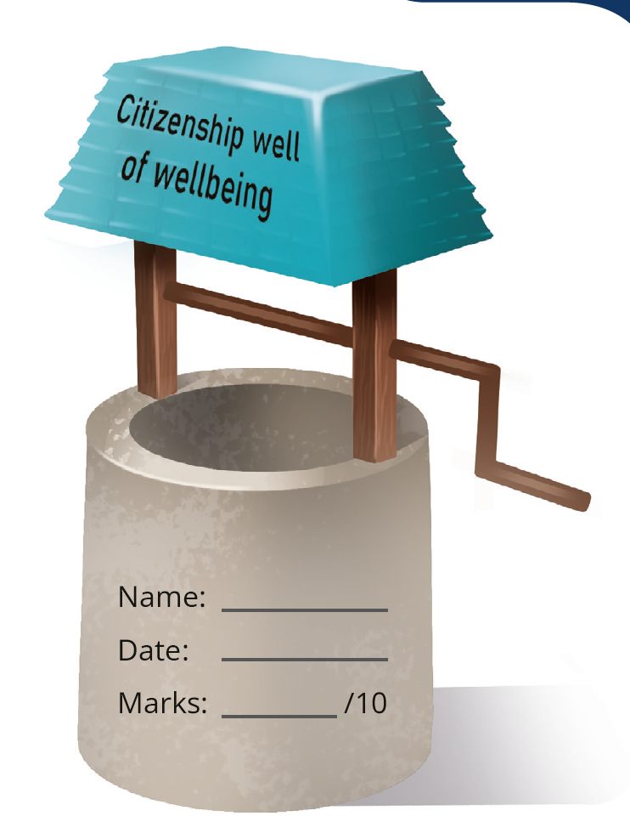
What is important in CSPE?
CH
Meeting the requirements of the Specification
Supporting the development of the ‘Well Citizen’
Teaching and learning in contemporary society
Enabling students to read the world
Engaging students
Empowering student voice and student agency
Active teaching and active learning
Capturing the learning
Making links to LC Politics & Society Course

Slide 8
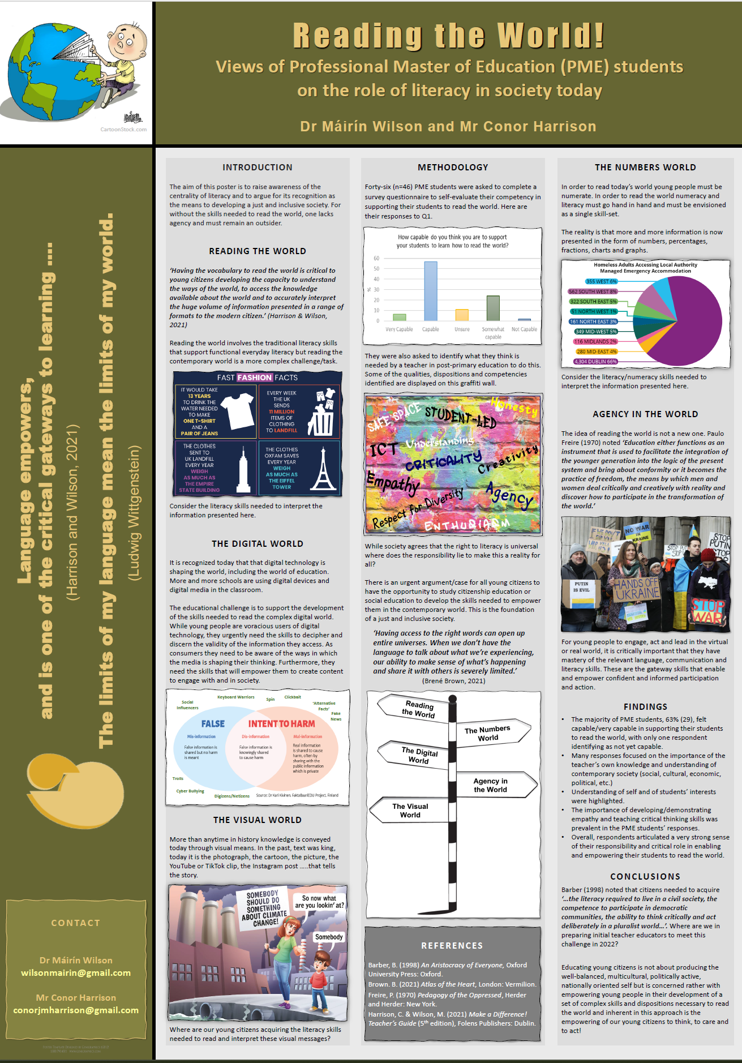
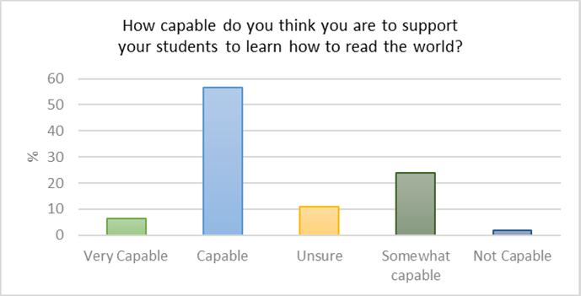
MW
PME Research
n =46

Slide 9
MW
Strand 1
Rights & Responsibilities (Foundational Strand)
Human Dignity – the basis for human rights
Strand 2
Global Citizenship
Sustainability
Strand 3
Exploring Democracy
Meaning of Democracy
Human Rights Instruments
Human Rights Action (x1)
Local & Global Development
Global Change
Global Citizenship Action (x1)
The Law and the Citizen
Media in a Democracy
Democracy Action (x1)
JC CSPE Short Course Outline

Slide 10
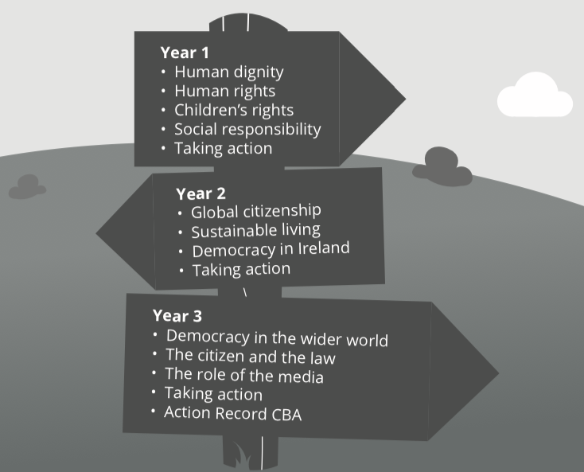
MW
Pathways

Slide 11

MW
Strand 2
Strand 3
Strand 1
Students should undertake ONE Action per Strand
Students complete ONE Action Record from any Strand

Slide 12
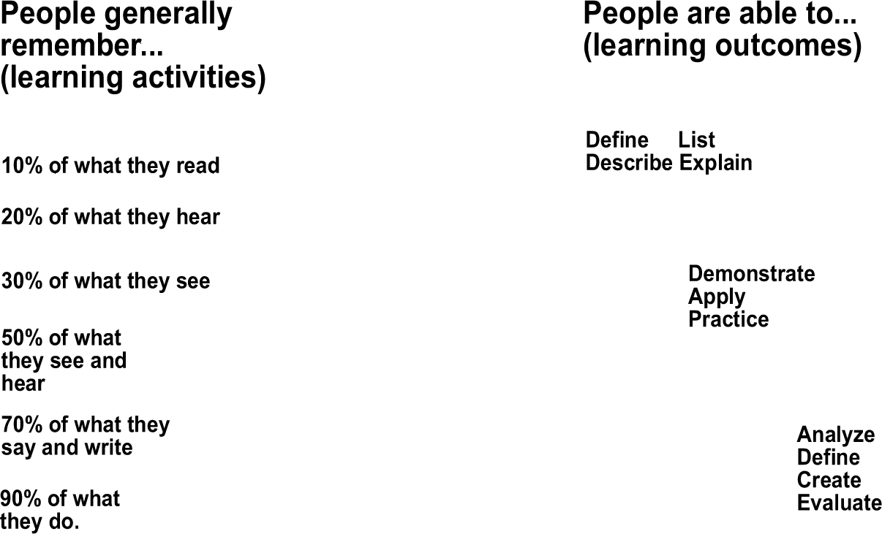

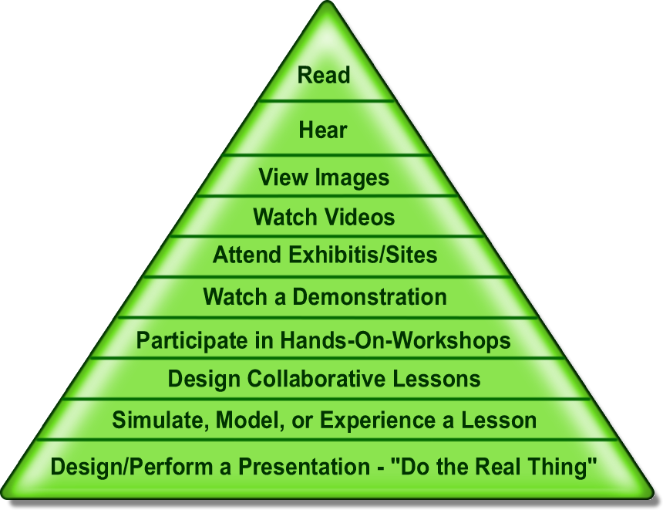


MW
Edgar Dale’s Cone of Experience

Slide 13
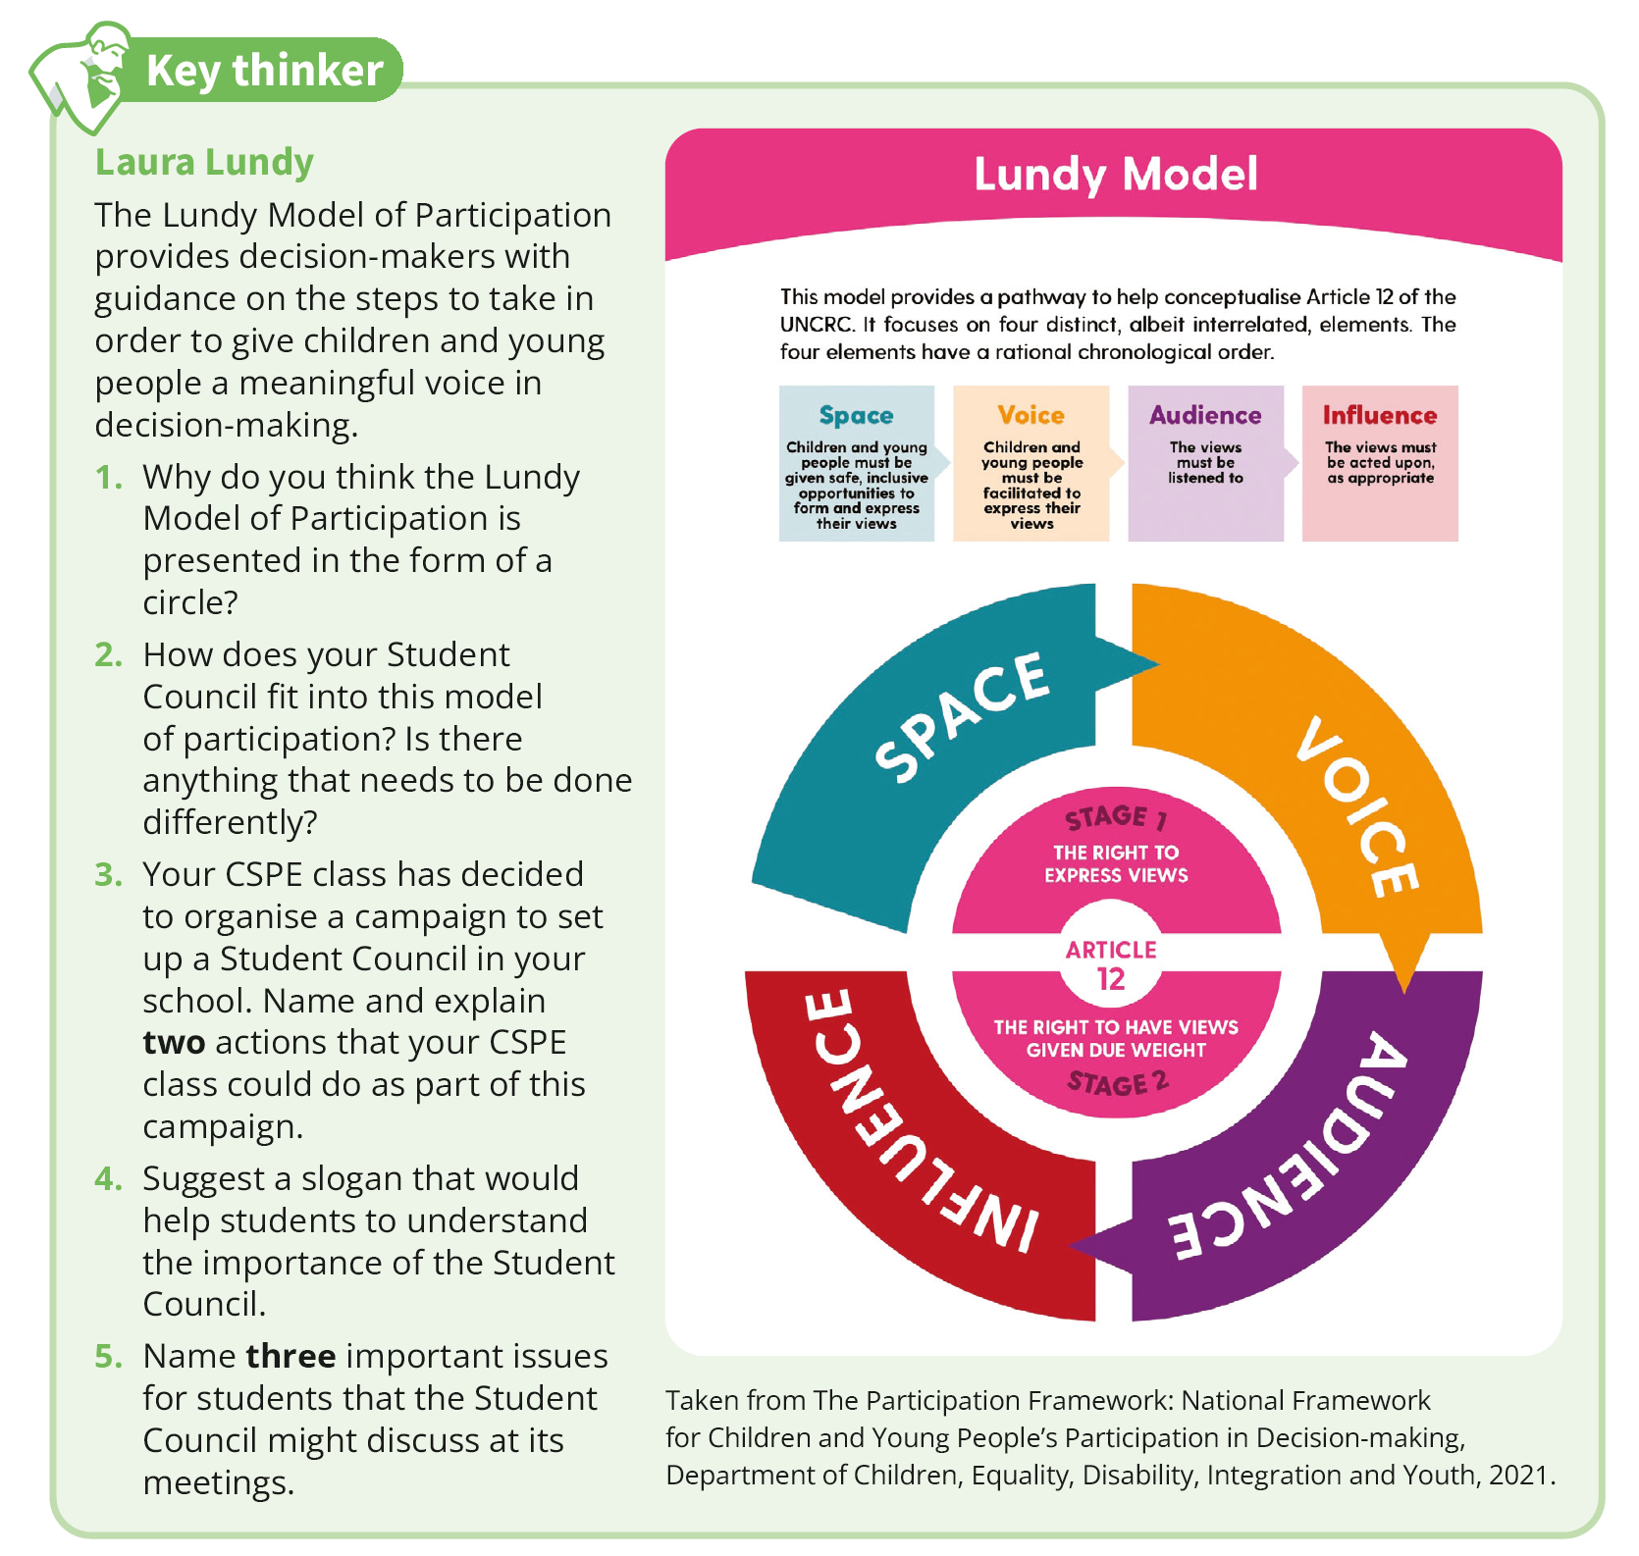
MW
The Lundy Model of Participation

Slide 14

MW
The emphasis in CSPE is on …
Content
Methodology
Action

Slide 15
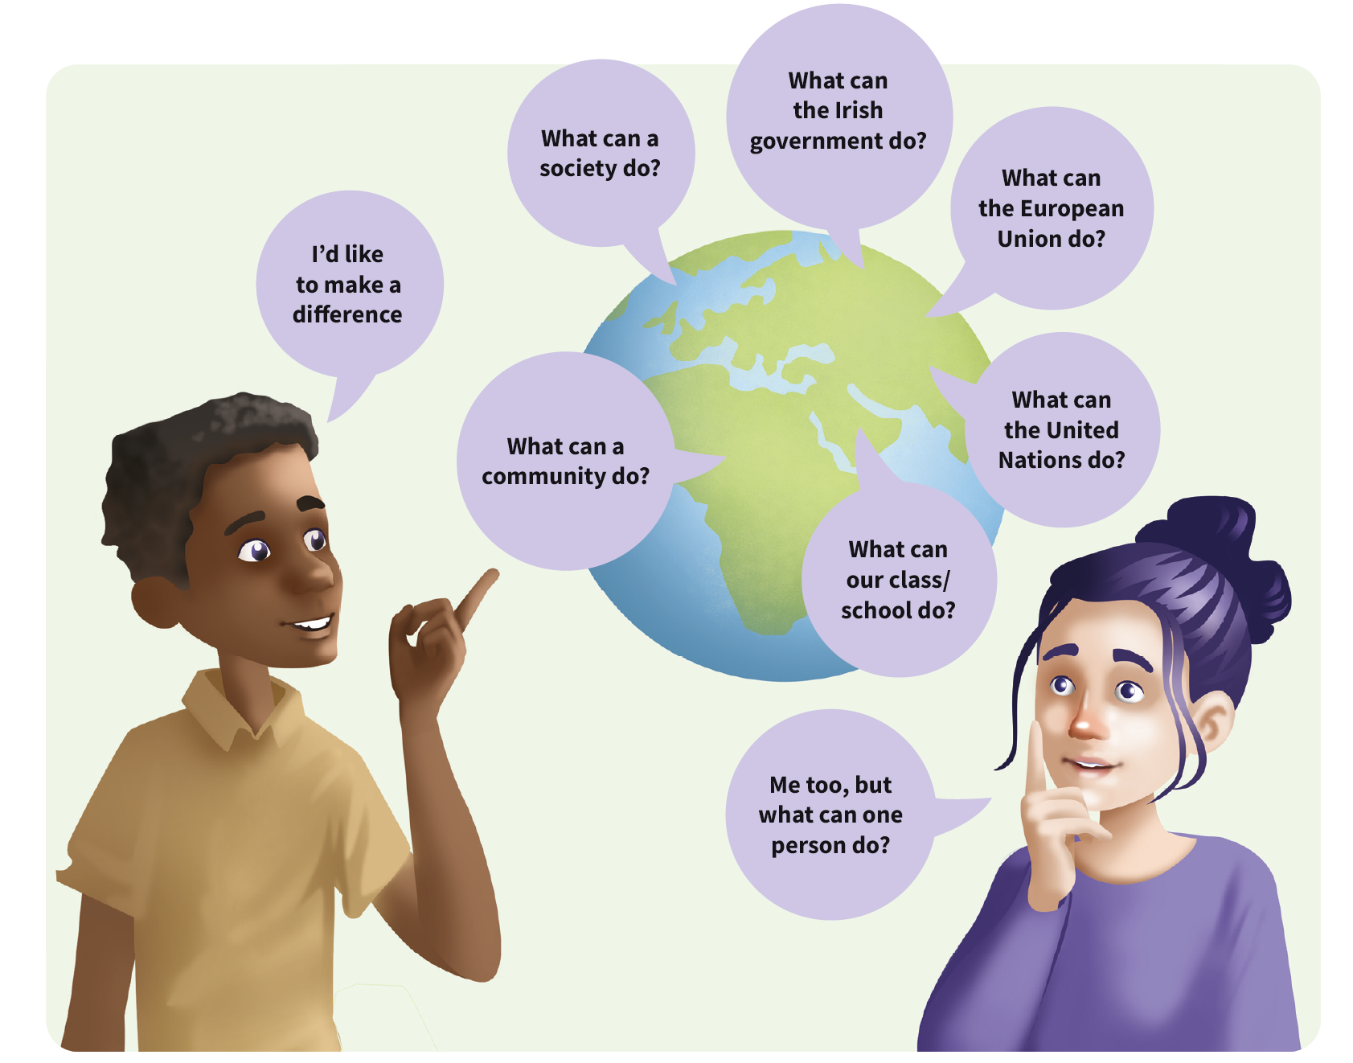
MW
How do YOU teach CSPE?
A teacher needs to include:
Reading the world
Active learning
Discussion/Exploring Attitudes
Teamwork
Critical thinking
Research
Taking action
Reflection
Fun!

Slide 16
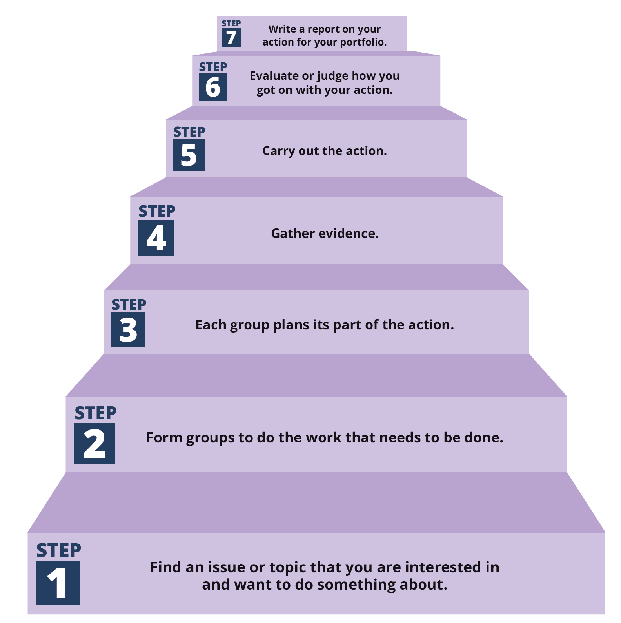
CH
What about Action?
Student led
Purposeful and meaningful
Manageable
Agency and empowering (Purpose)
Response to contemporary event
Real world
Knowing how to do this
ideas, steps, reporting

Slide 17
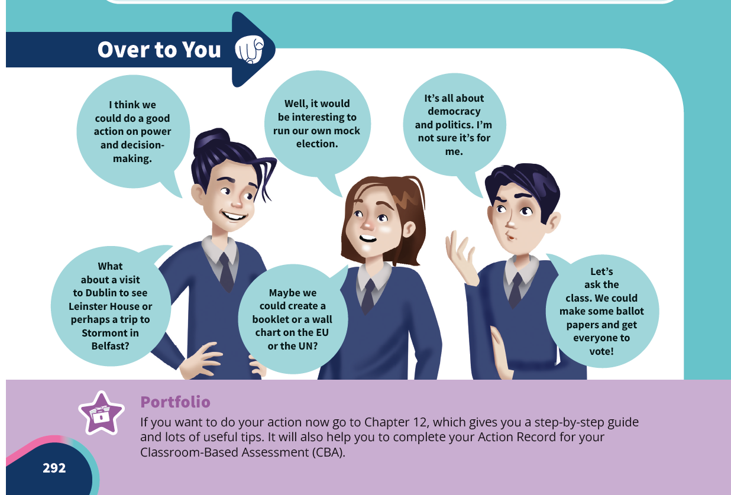
CH
Teasing out
Action Ideas
(at the end of every Chapter)

Slide 18
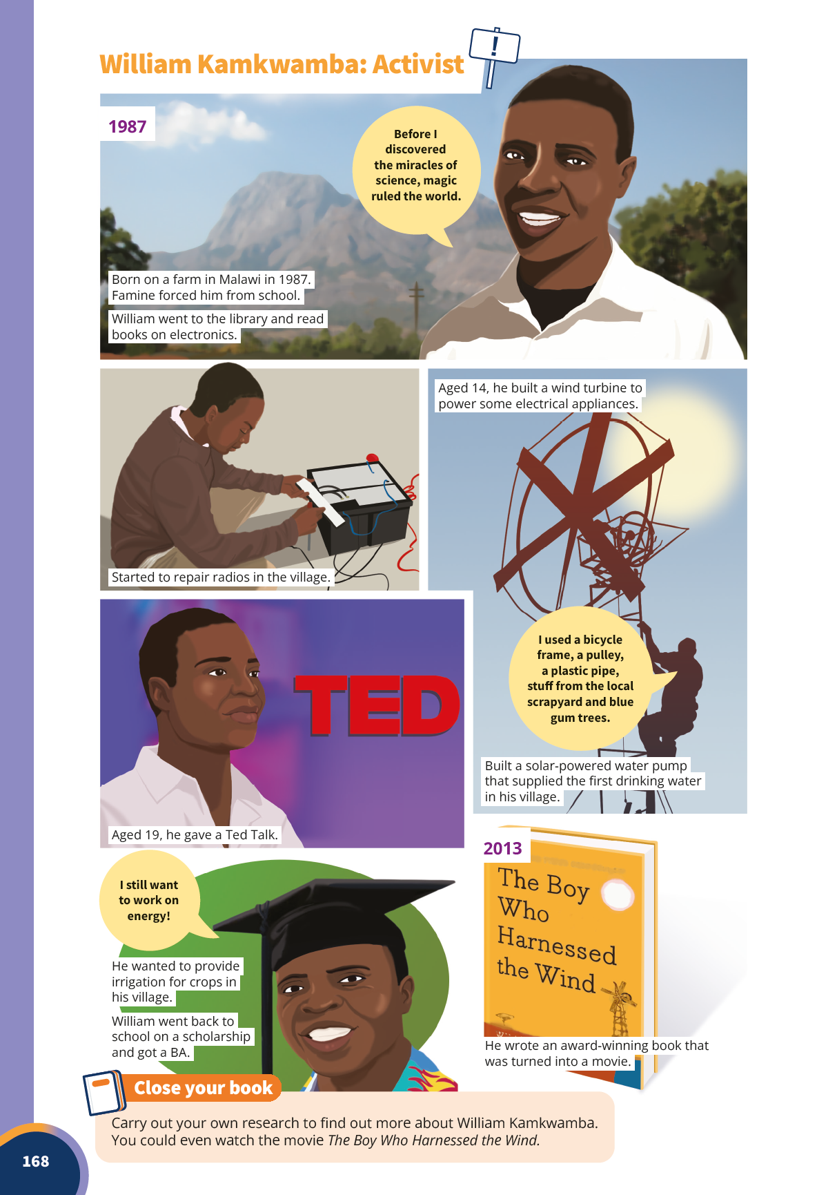

CH
Inspirational Activists
(at the end of every Chapter)

Slide 19
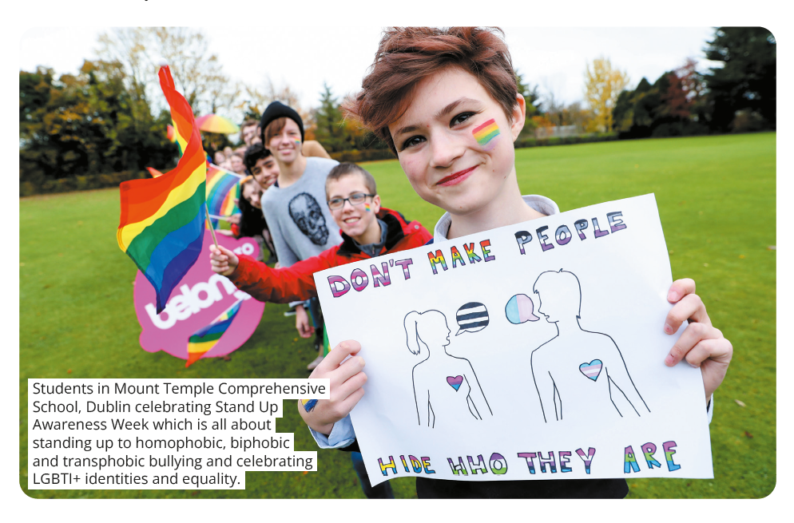
CH
Sample
CSPE Actions
(Chapter 12)

Slide 20
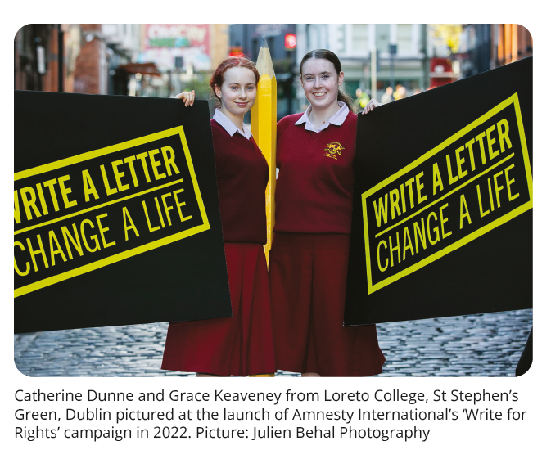
CH
Sample
CSPE Actions
(Chapter 12)

Slide 21
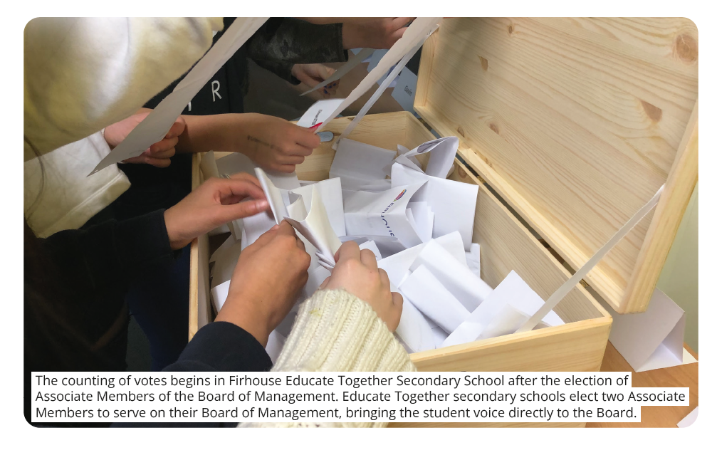
CH
Sample
CSPE Actions
(Chapter 12)

Slide 22
MW
Ideas from Politics & Society Citizenship Projects
1. Research the environmental impact of ‘Fast Fashion’. Use your findings to raise awareness of this problem by holding an event to promote environmentally sustainable fashion.
2. Investigate whether imposing an age restriction on smart phone ownership would be a protection or a denial of children’s rights. Using your findings, make recommendations on this topic to the Minister for Children and to a relevant children’s organisation.
3. Examine the issues around granting the vote in general elections to Irish citizens living outside the State. Use your findings and informed opinions to lobby a politician of your choice.
4. Establish through research whether hate crime/hate incidents are an issue for young people in Ireland. Use your findings to inform a day in your school that celebrates diversity and inclusion.
1. Using some contemporary examples, investigate the view that the ‘climate crisis’ is a human rights issue. Use the analysis of your findings to write a submission to a relevant agency, media outlet or political representative at local or national level.
2. Investigate the model and function of the Irish Citizens’ Assembly as an exercise in deliberative and representative democracy. Create an awareness campaign or event aimed at promoting understanding about the Irish Citizens’ Assembly as an exercise in deliberative democracy.
3. AI is an example of the changing nature of contemporary media in society. Investigate whether this new media is a threat or an opportunity to society. Hold an event to share your findings.
4. Create an exhibition or display where you use your findings to inform young people about this issue. Investigate how power can be exercised by young people in society today. Use your findings to inform a school-based action.
Dr Máirín Wilson

Slide 23





MW
Chapter 12 (Textbook): Action,
Reflection & Assessment

Slide 24
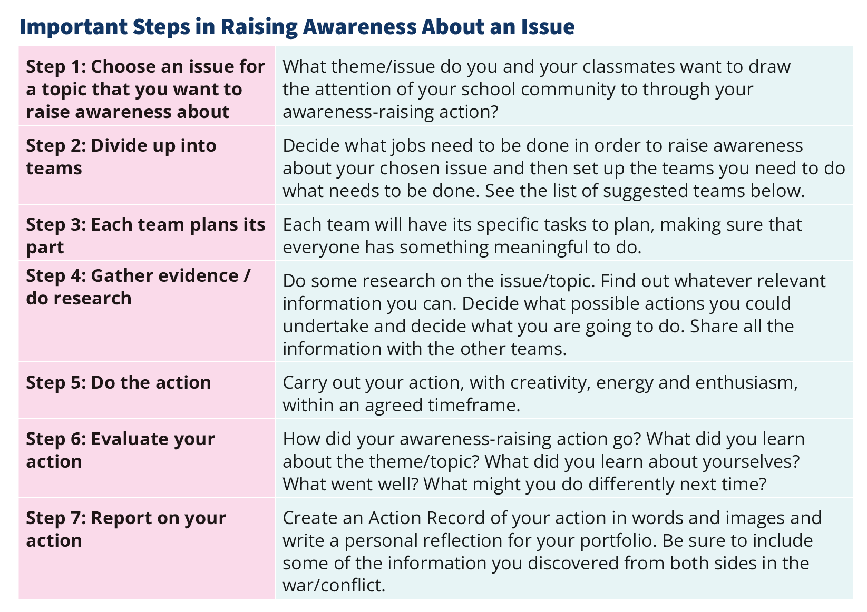
MW
Important Steps in Planning an Action – Chapter 12
For 9 different Actions:
Designated Day/Week
Guest Speaker
Raising Awareness
Exhibition/Display
Organising a Debate
Running a Campaign
A School Survey
A School Election
A School Trip/Visit

Slide 25
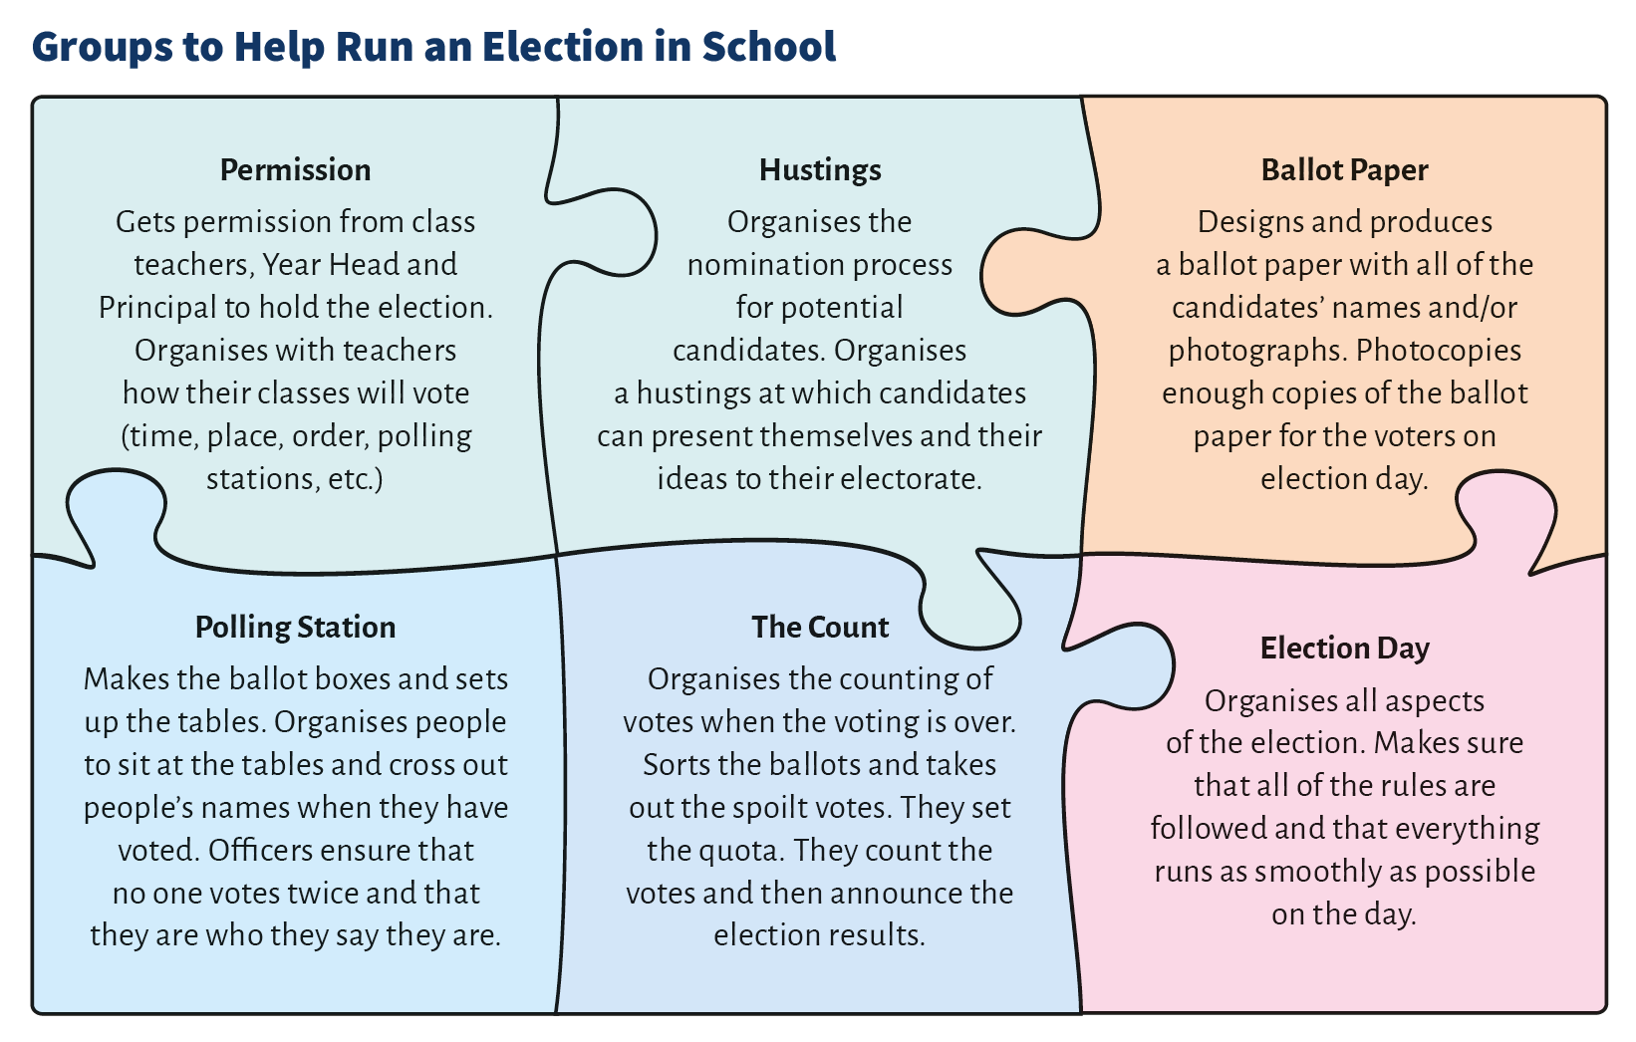
MW
Groups to do the Action – Chapter 12
For 9 different Actions:
Designated Day/Week
Guest Speaker
Raising Awareness
Exhibition/Display
Organising a Debate
Running a Campaign
A School Survey
A School Election
A School Trip/Visit

Slide 26
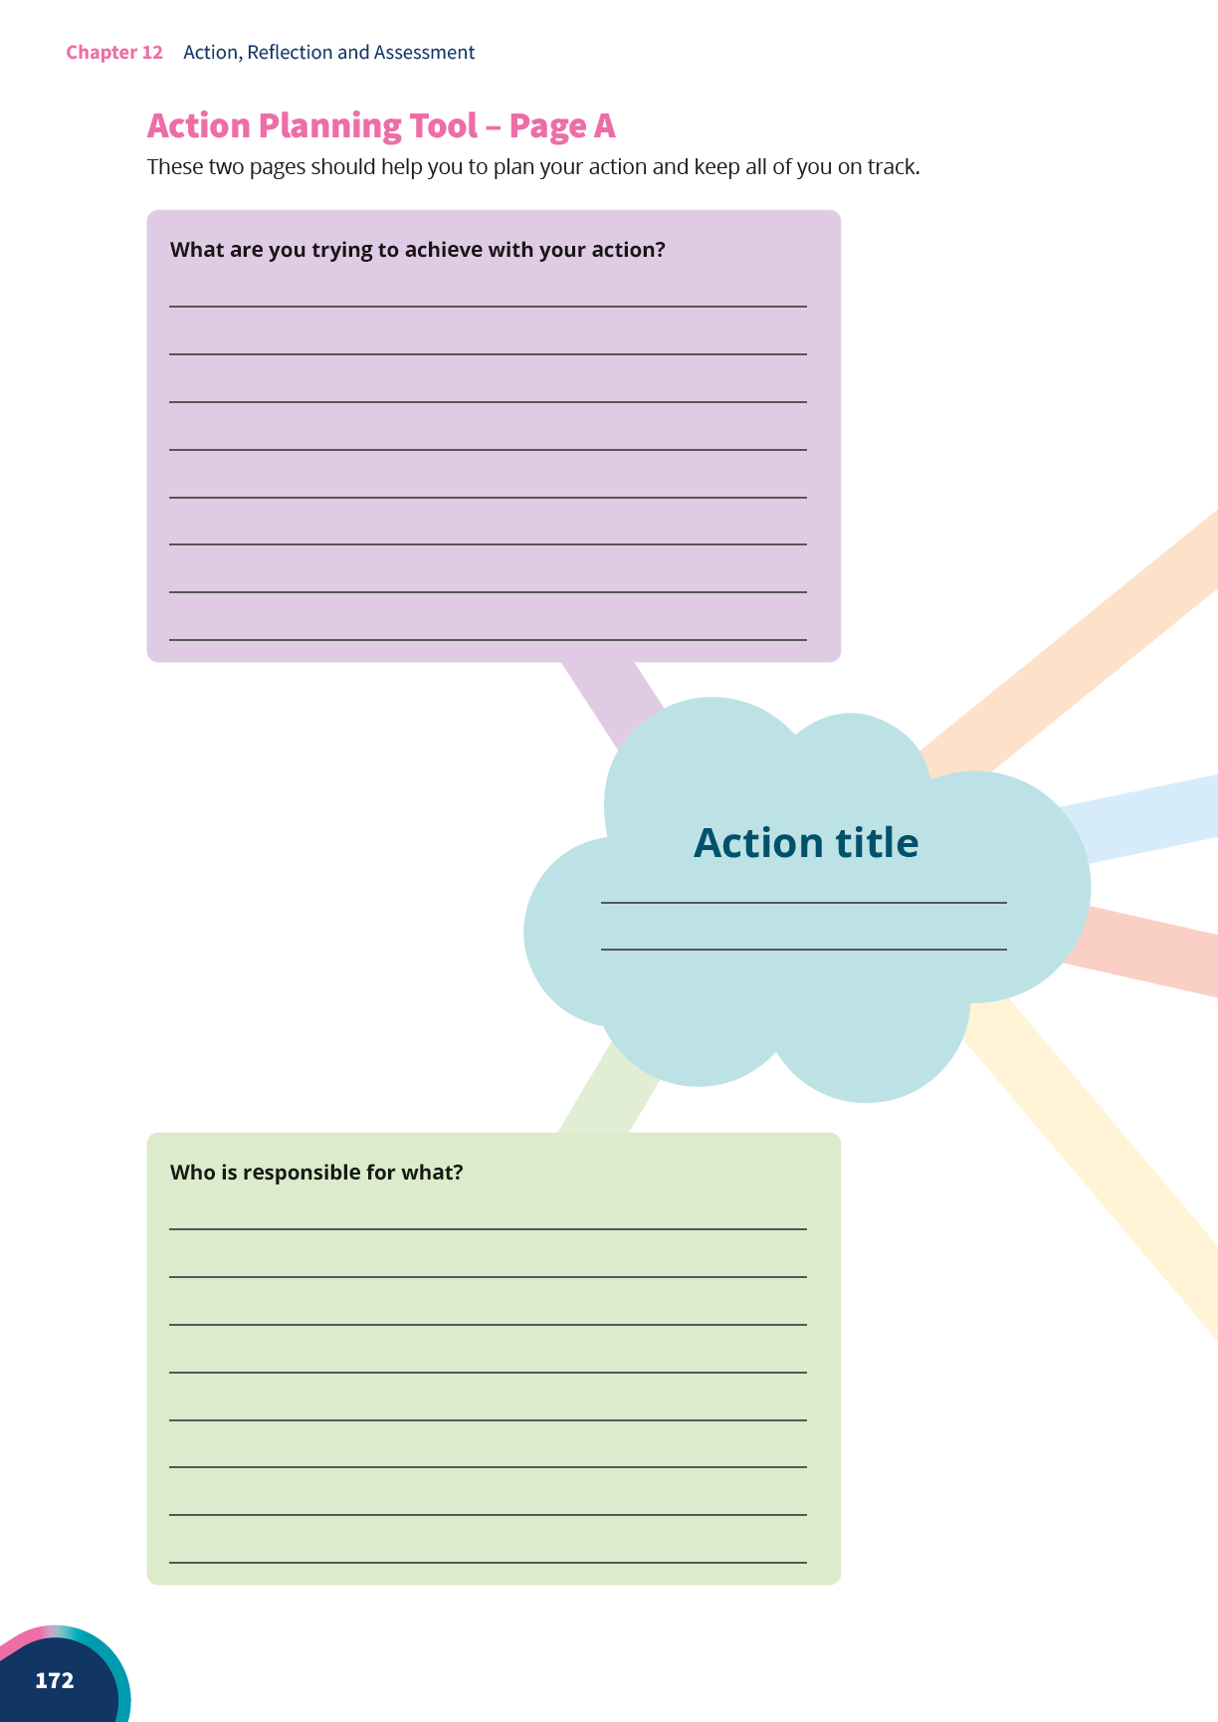
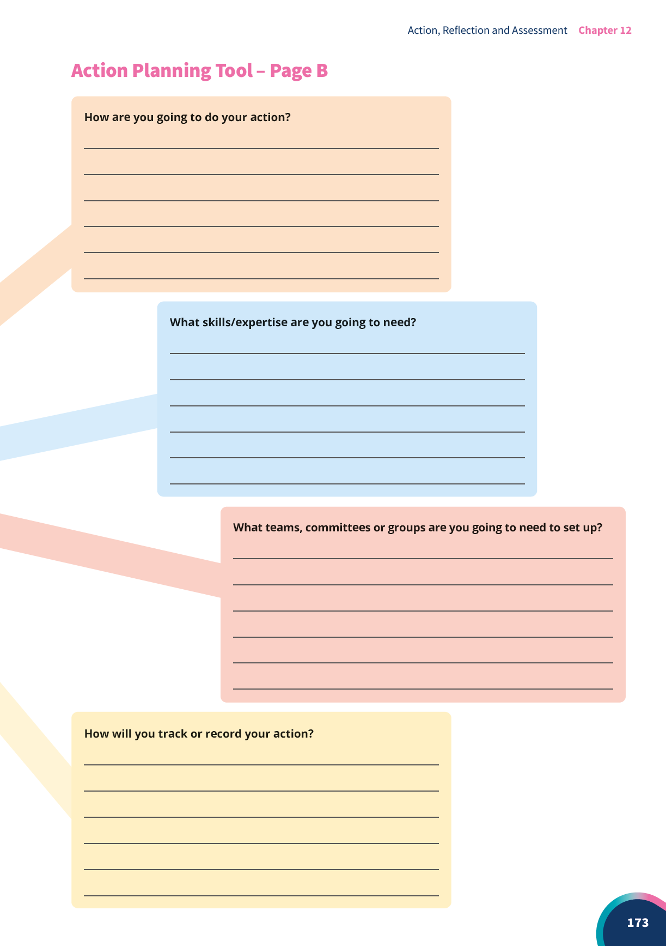
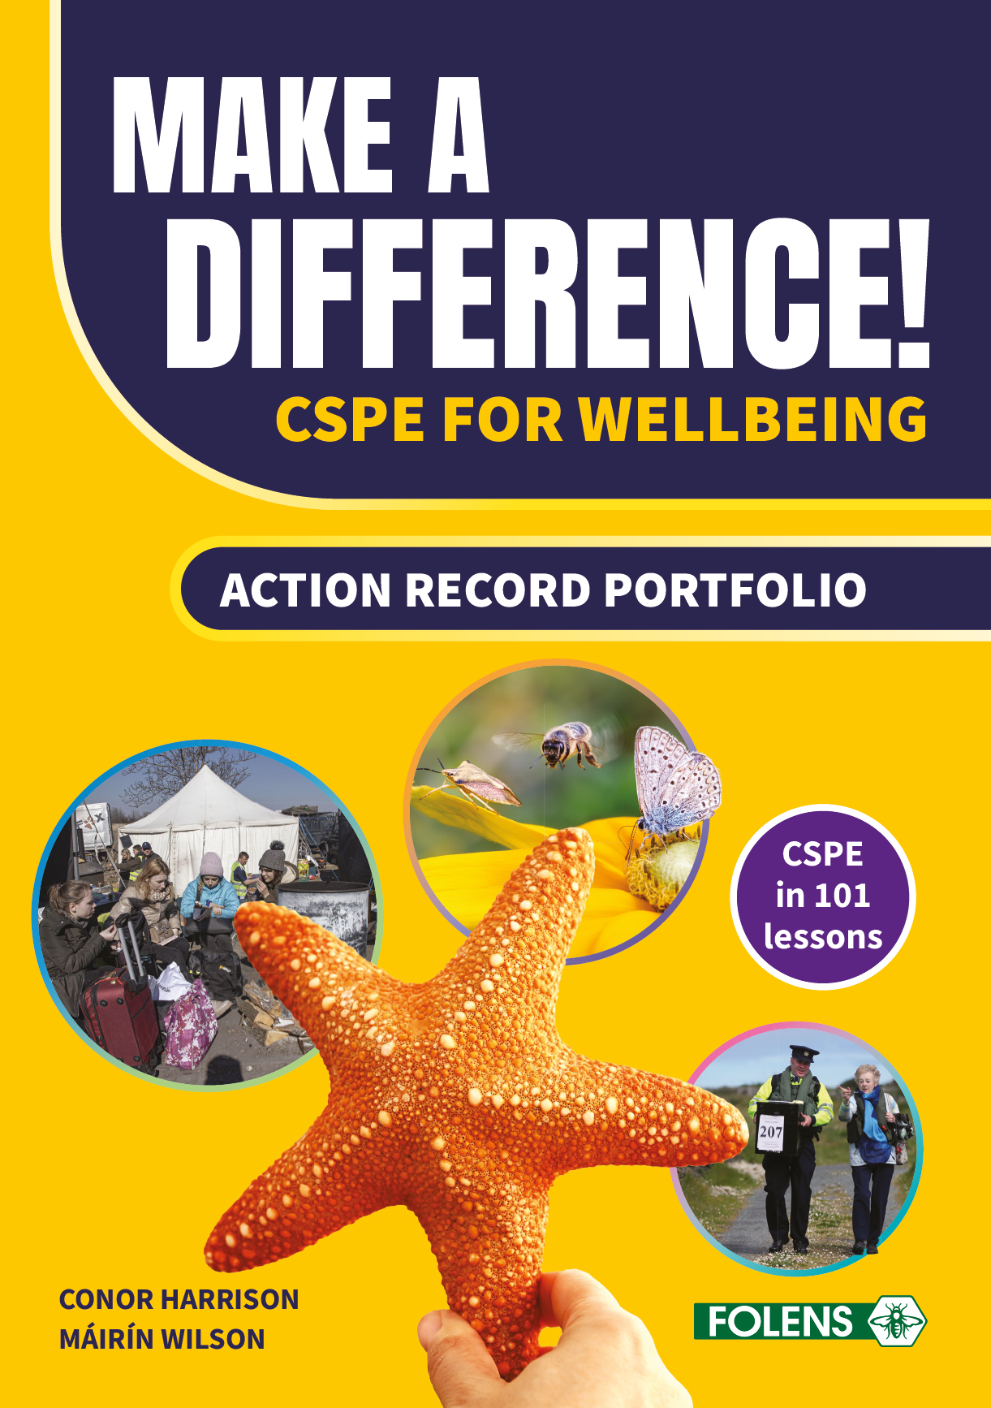
CH
Chapter 12

Slide 27
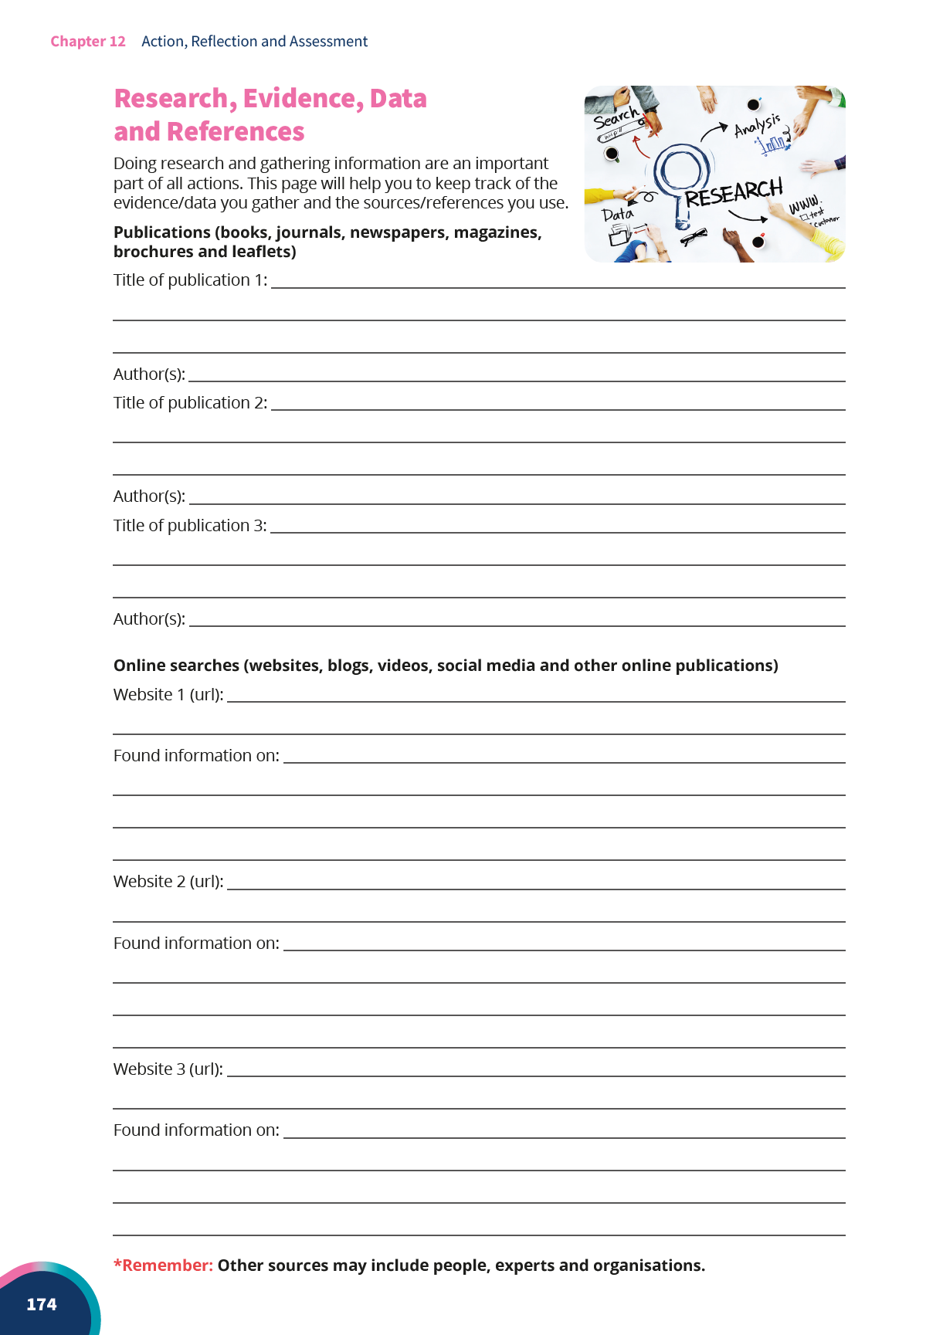
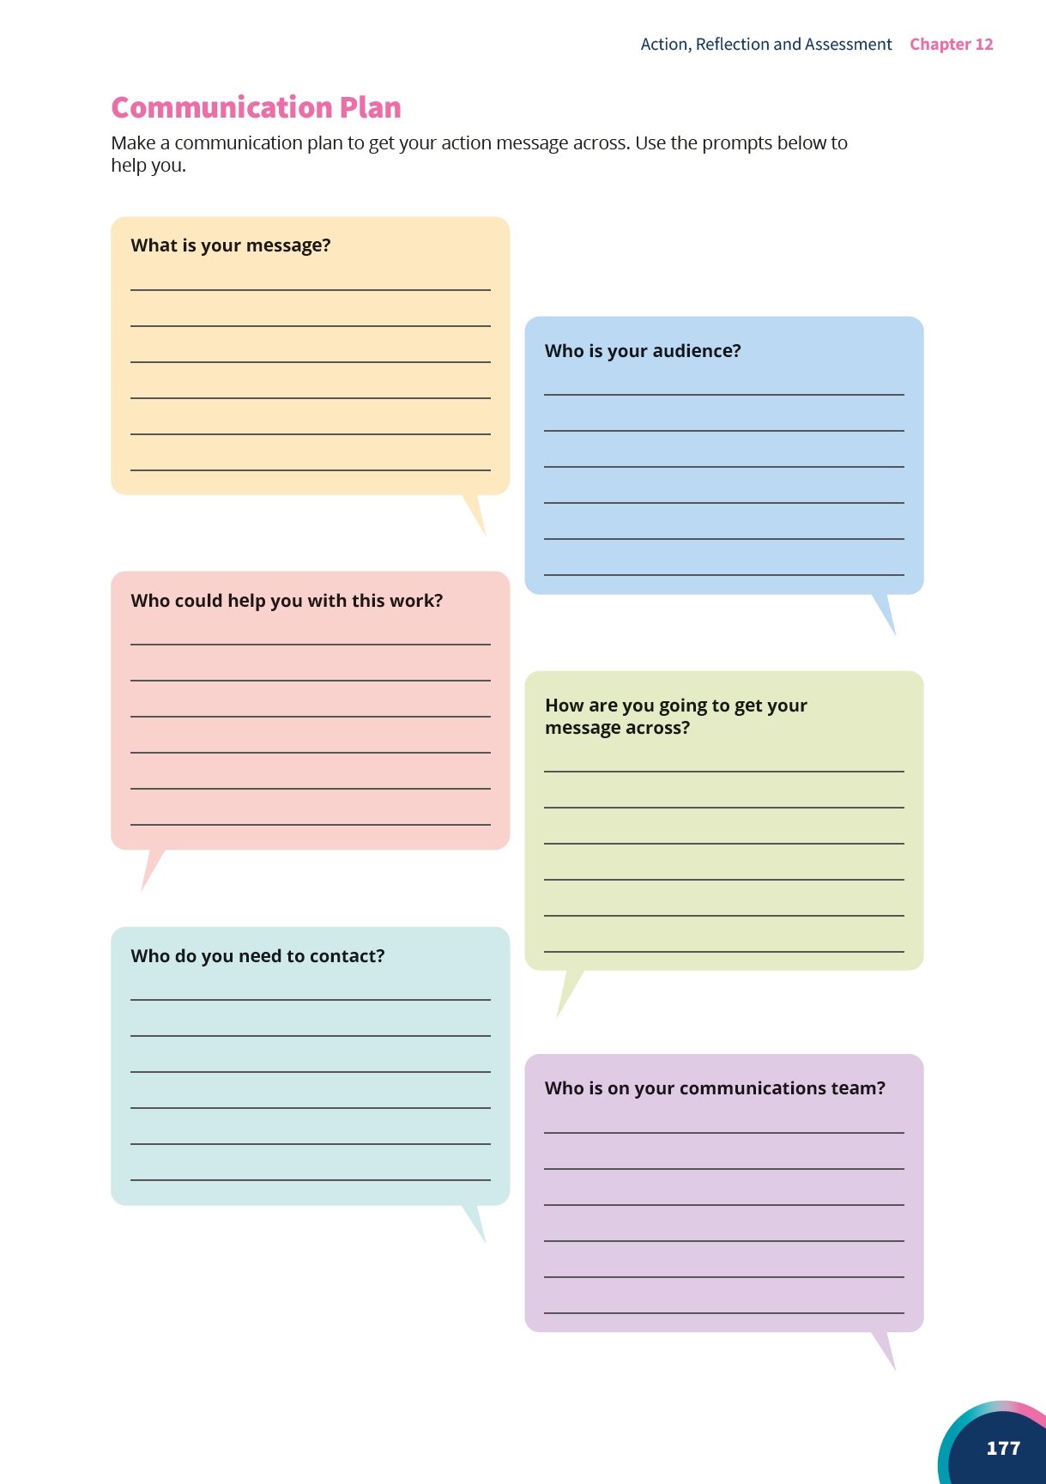
CH

Slide 28
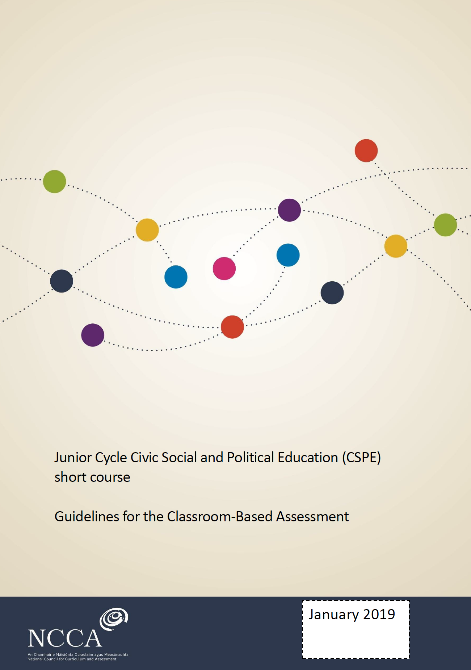
CH
CSPE Action Record (CBA)
Written
Digital
Visual
Audio
Supported through
Interview
Presentation

Slide 29
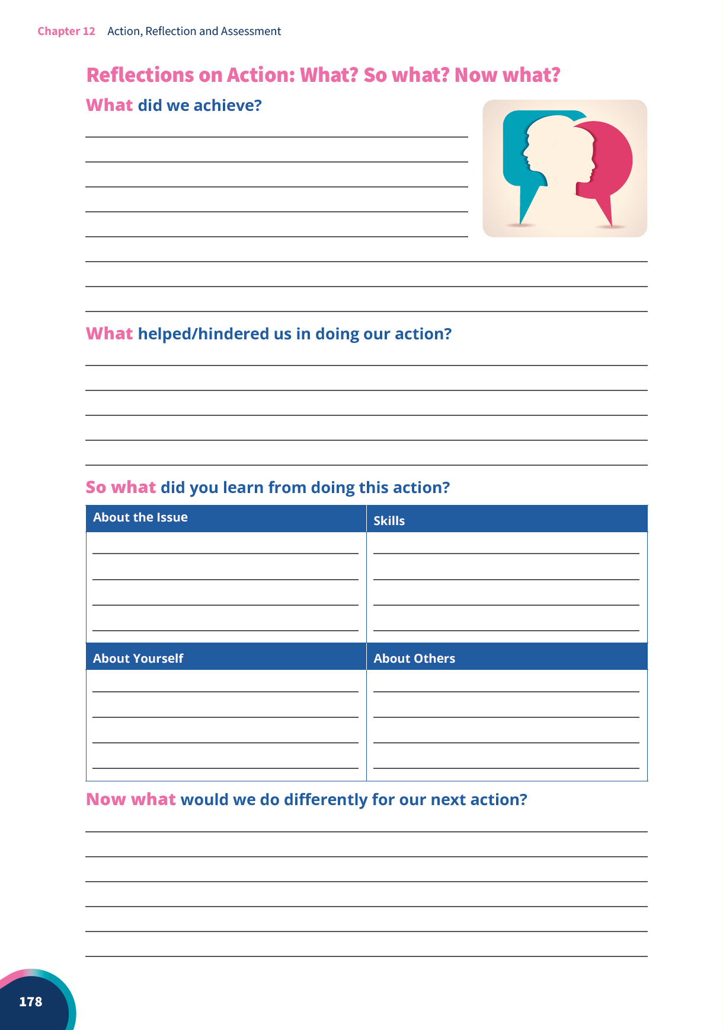
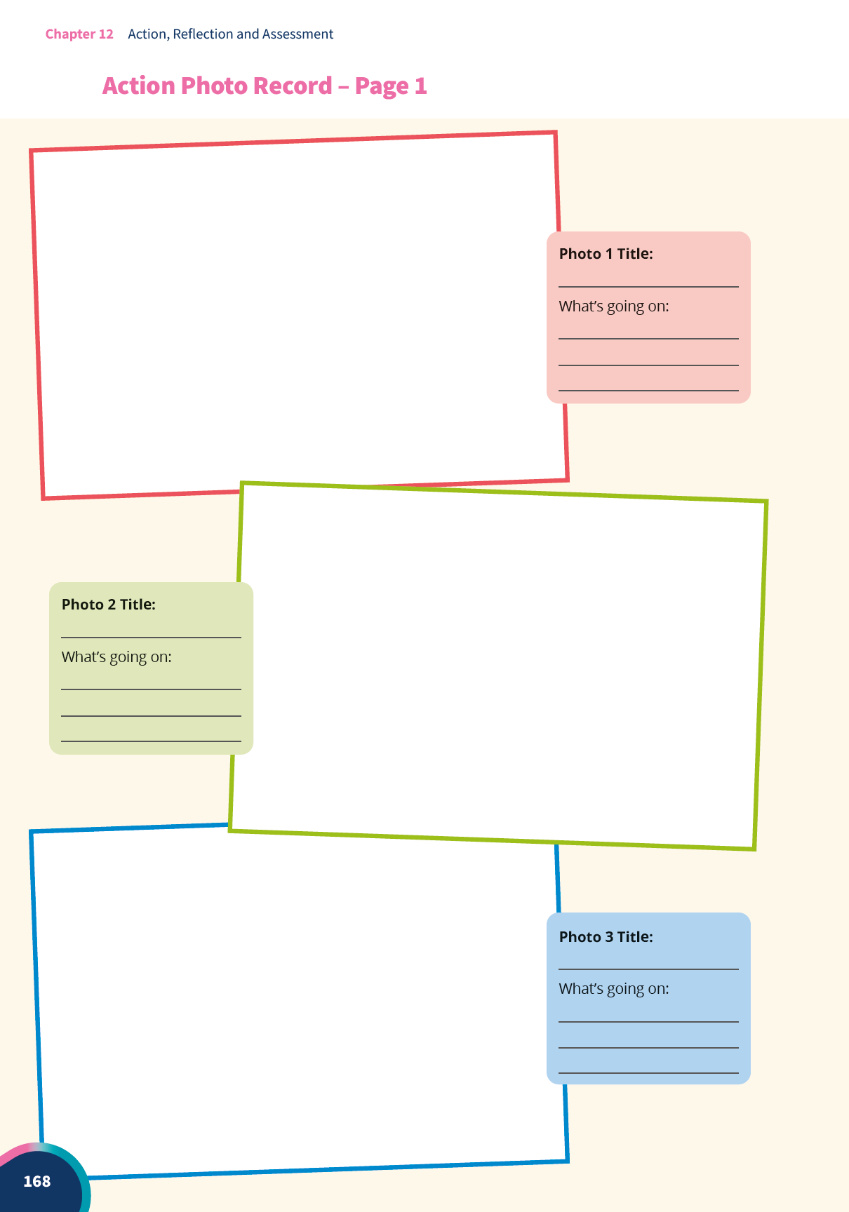
CH

Slide 30
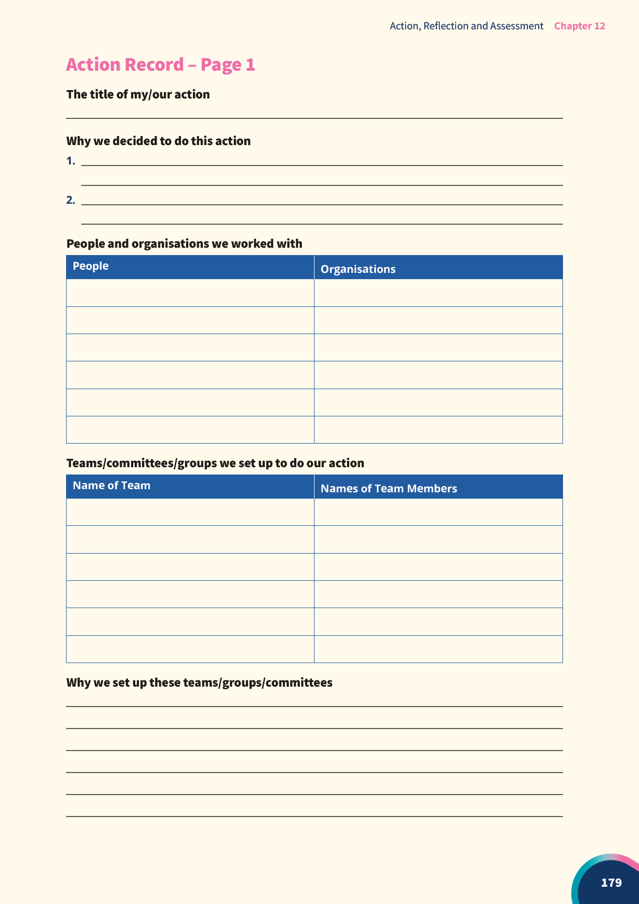

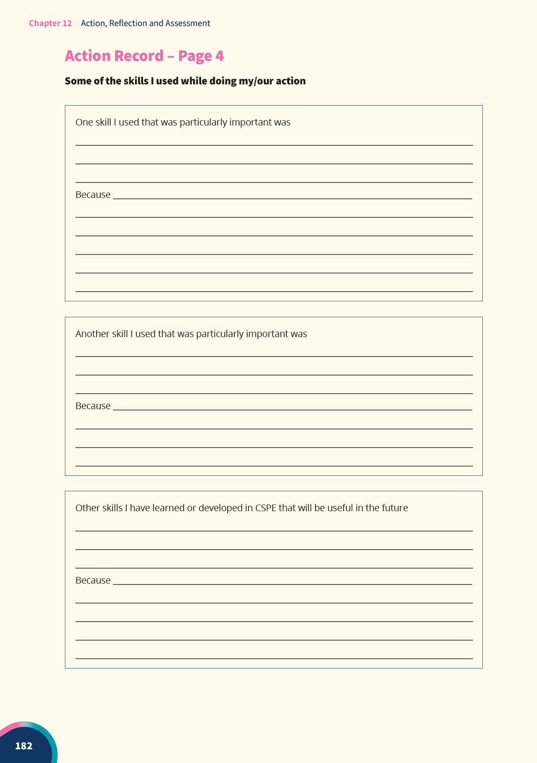
CH

Slide 31
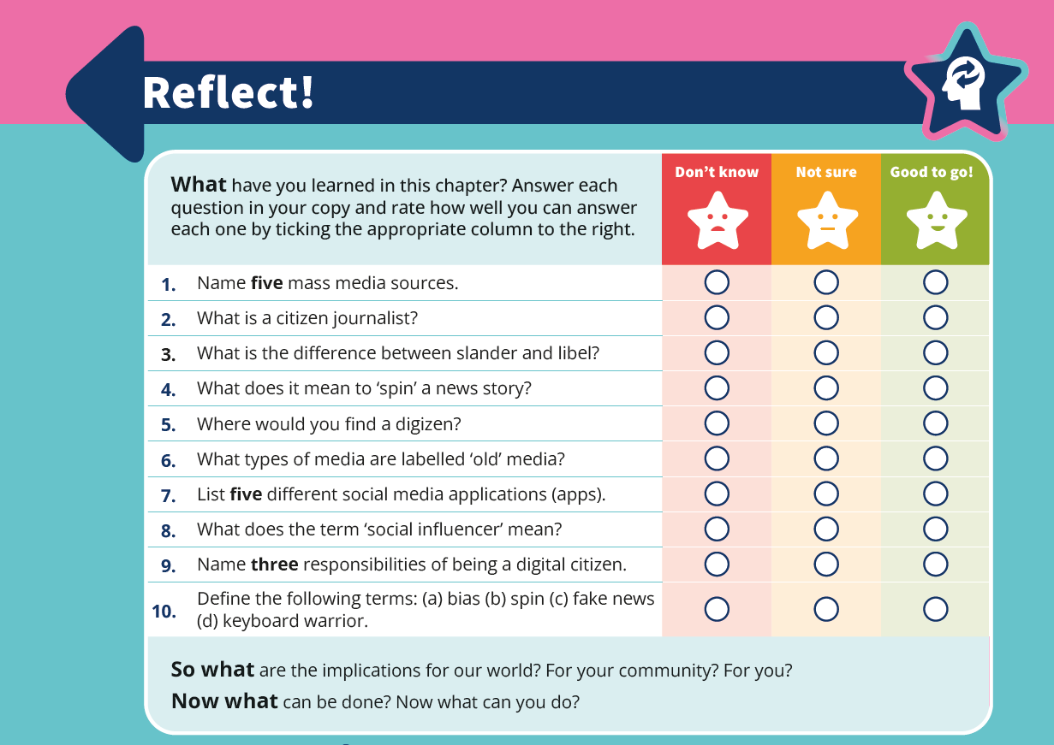
MW
How do you manage CSPE assessment?
Formative (QQ, ARP)
Questioning
Peer work
Self-assessment
Recording student work
Portfolio
Feedback
Celebrating
Summative
Homework
Test / Exams in Teacher’s Guide
End of Chapter Reflect! Review

Slide 32
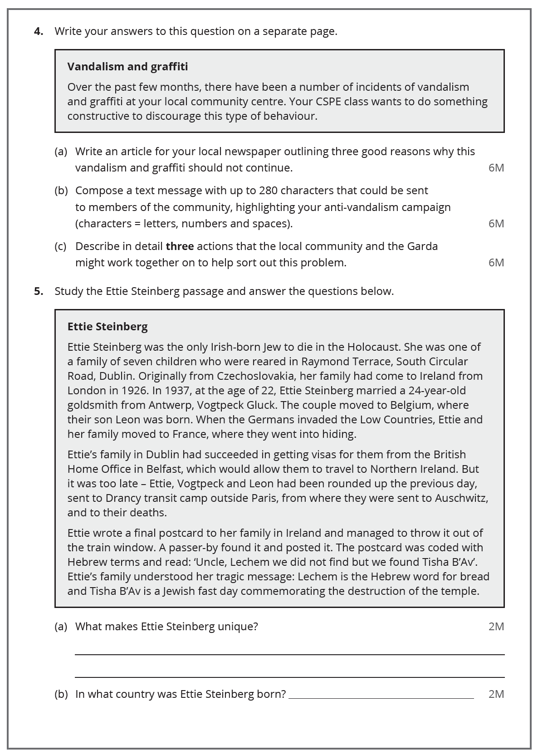
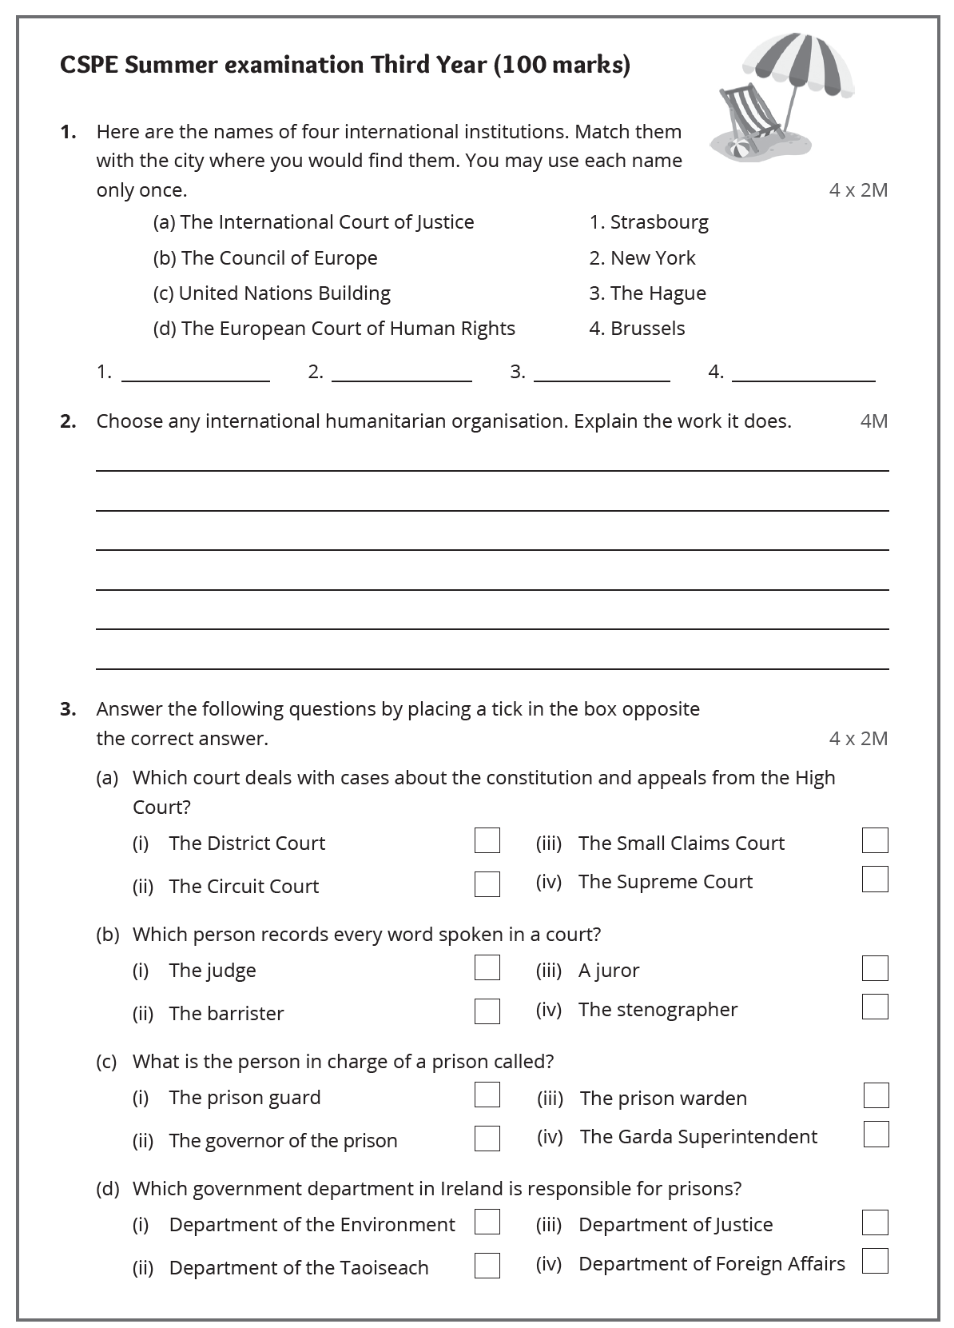
MW
Tests and Exam Papers

Slide 33
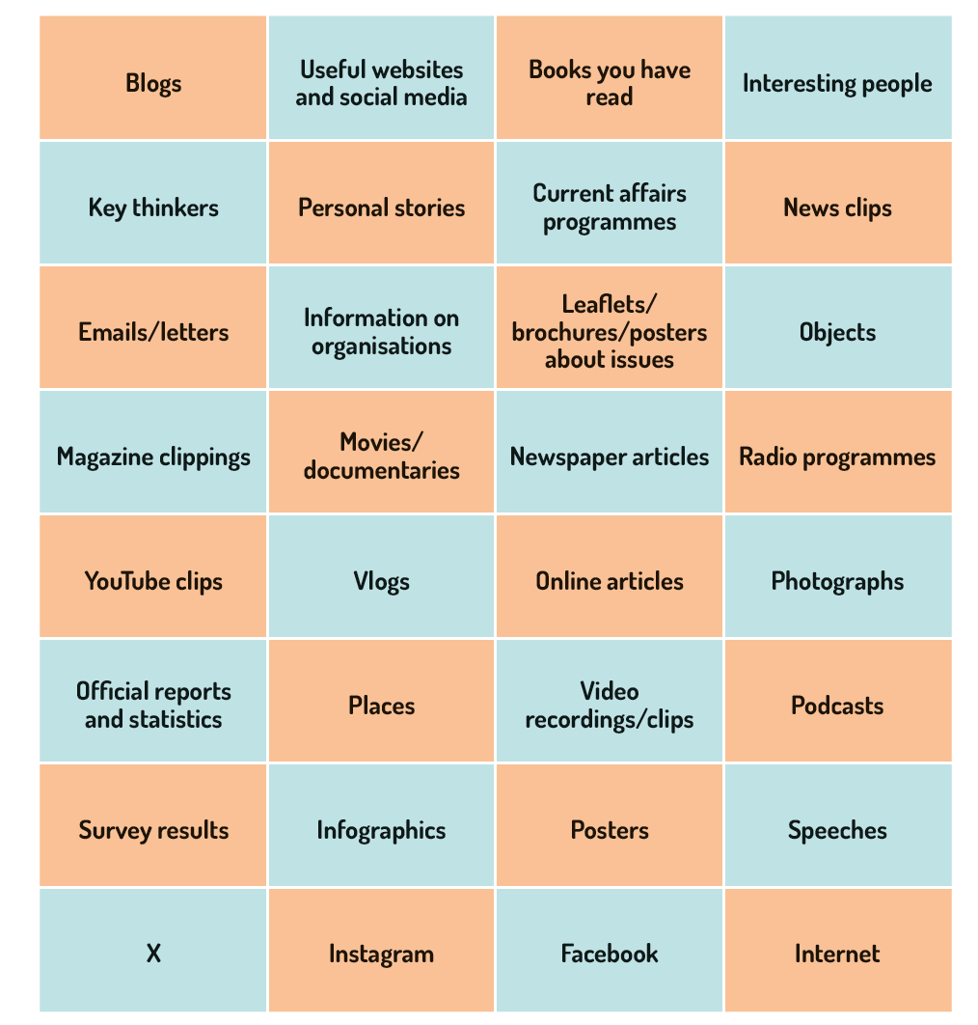
MW
Gathering Evidence
&
Doing Research

Slide 34
MW
Action Record Features of Quality
Exceptional
The action record shows how the student fully and effectively engaged in meaningful action. The student’s personal reflections on their learning are of excellent quality. The record is presented in a comprehensive, creative and highly effective manner.
Above Expectations
The action record provides evidence of how the student engaged in meaningful action. The student’s personal reflections on their learning are of good quality. The record is presented in an organised, creative and effective manner.
CSPE Guidelines for the Classroom-Based Assessment (2019) p. 12

Slide 35
MW
Action Record Features of Quality (continued)
In line with Expectations
The action record provides evidence of the student’s engagement in the action. There is some evidence of personal reflection on their learning. The record is presented in an organised manner with some creativity.
Yet to meet Expectations
The action record provides limited evidence of personal engagement in the action taken. There is very limited evidence of student reflection on learning. The record provides a very basic summary of information although it may lack detail and creativity.
CSPE Guidelines for the Classroom-Based Assessment (2019) p. 12

Slide 36
Check out the teaching package on Folens.ie
CW

Slide 37


CW
Your Local Folens Rep
Available for meetings at a time that suits you
Support you with your classroom needs
Support for upcoming book scheme
Contact your Rep on Folens.ie!

Slide 38
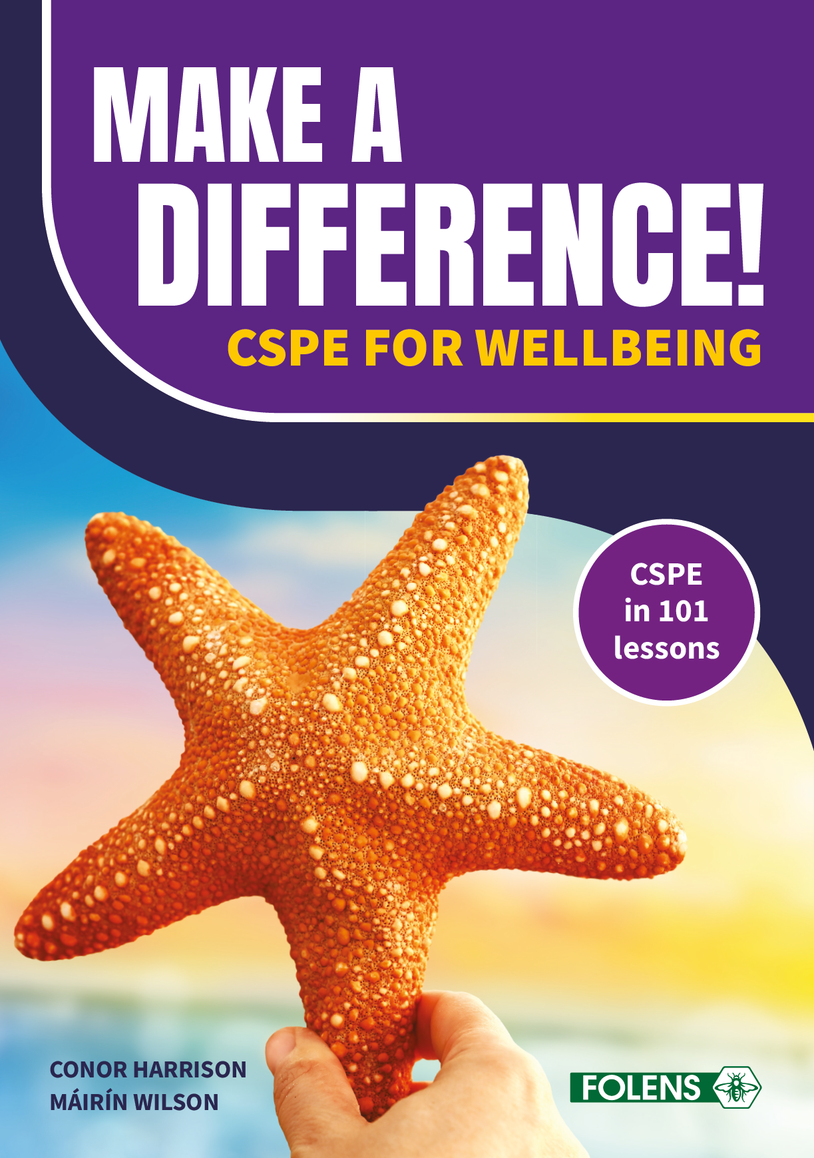

CH & MW
Enjoy looking at the books! – Folens.ie

Slide 39

CH
If you and your students do any interesting actions be sure to let us know. We’d love to hear from you!

Slide 40

MW
A young lad was walking down a deserted beach after a major storm. He was astonished by the number of starfish that the storm had washed up on the beach. He thought that there was nothing he could do because there were so many.
In the distance he saw a frail old woman. As he approached the woman, he saw her bend over, pick up a stranded starfish and throw it back into the sea. The young lad gazed in wonder as the old woman, again and again bent over, picked up stranded starfish and threw them from the sand to the water. He asked, ‘Why do you spend so much energy doing what seems to be a waste of time?’ The old woman explained that the stranded starfish would die if left in the morning sun.
‘But there must be thousands of starfish on this beach alone!’, exclaimed the young lad. ‘How can you make a difference?’ The old woman looked at the small starfish in her hand and, as she threw it to the safety of the sea, she said, ‘I made a difference to that one, didn’t I?’
The Starfish/Make A Difference! Story
Adapted from ‘The Star Thrower’ by Loren Eisley

